Slide 1
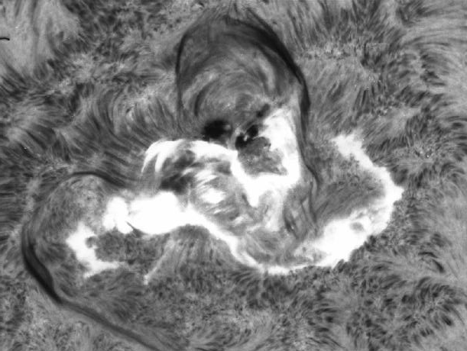





HaSTeNet a European Hα Solar Telescope Network for SSA
F. Clette, M. Temmer, A. Veronig, F. Zuccarello, J-M. Malherbe
SIDC – Royal Observatory of Belgium
Kanzelhöhe Observatory, University of Graz
INAF - Catania Observatory, University of Catania
LESIA - Observatoire de Paris-Meudon

Slide 2
HaSTeNet: An operational H-alpha network for SSA
ESA optional programs (Intended invitation to tender):
  GSTP5, segment 3 (Security for the Citizen)
Call ID 10.1EE.02: H-Alpha Solar Telescope NETwork prototype for applications (HASTENET)
Budget: 200-500 KEURO
See call on emits.esa.int
Coordinated network
Operational service
Hα whole-disk monitoring
Connection with solar space data
User-oriented products and applications

Slide 3
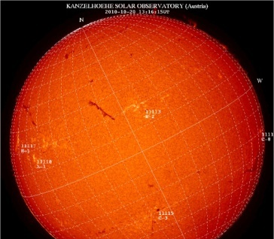
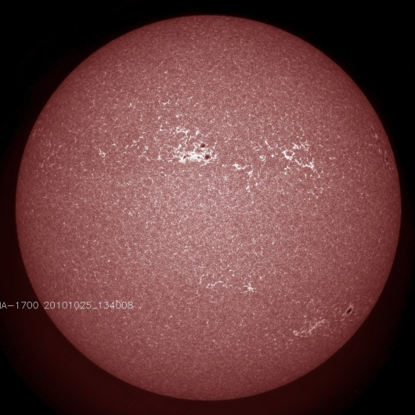
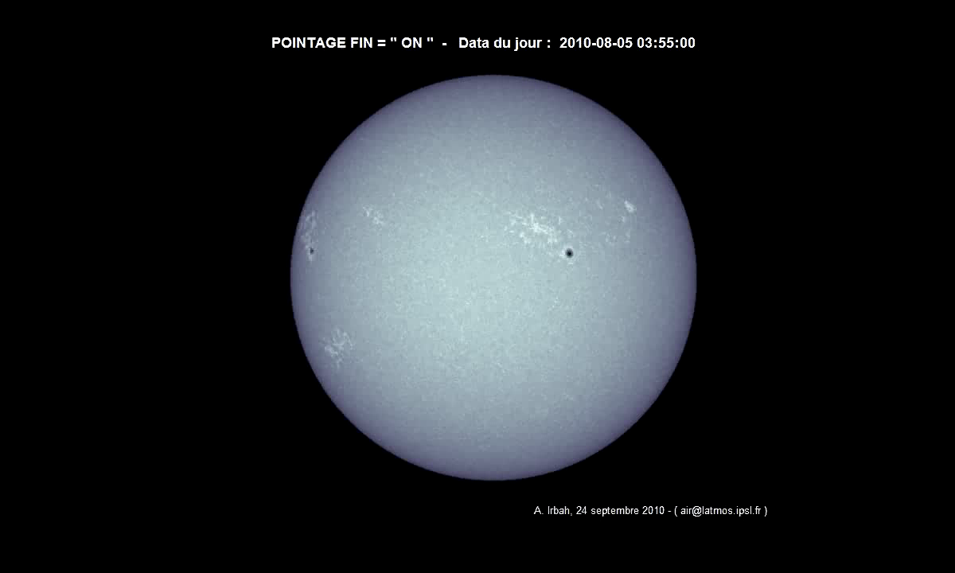
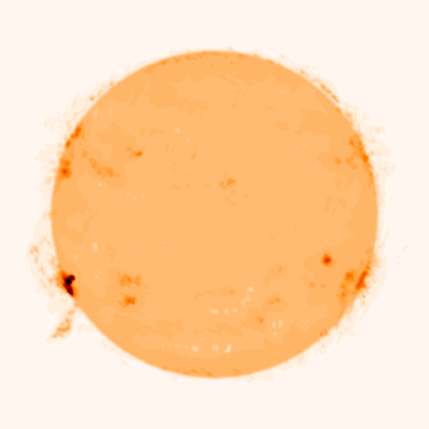
A chromospheric view: Hα versus other wavelengths
The chromosphere = missing link in current space weather studies
Unique Hα solar features and events
Full complementarity with
space solar data
SDO_AIA, 1700A
Nobeyama, radio, 17GHz
PICARD – SODISM, CaII-K

Slide 4
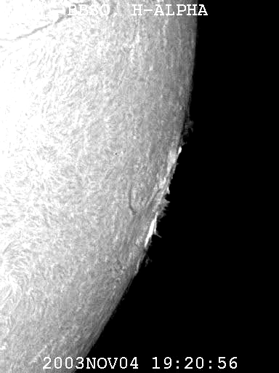
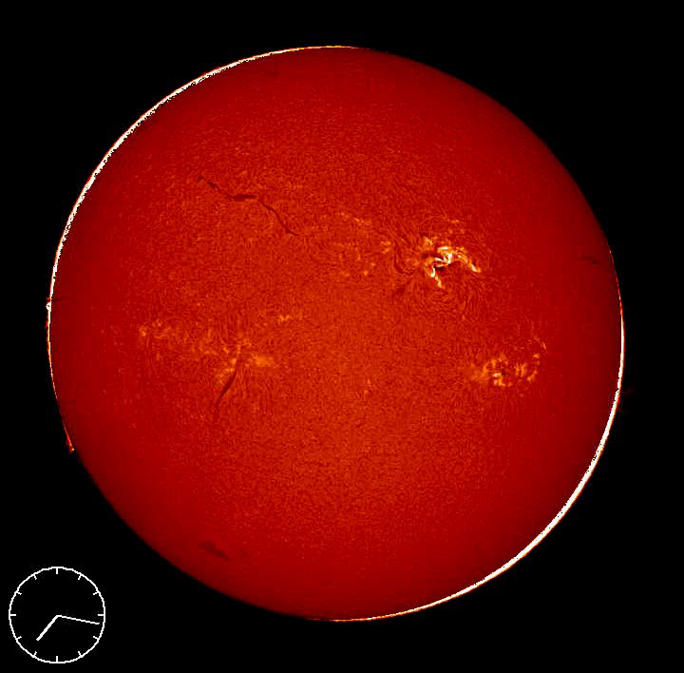
SW product 1: Flare diagnostics
Real-Time: alerts, location, timing, brightness, area
Diagnostics:
  Precursors
  Energy release
  Topology: ribbons, loop connectivity
Which magnetic loop footpoints are involved in the reconnection?
Obs. Kanzelhöhe, 17/1/2005

Slide 5
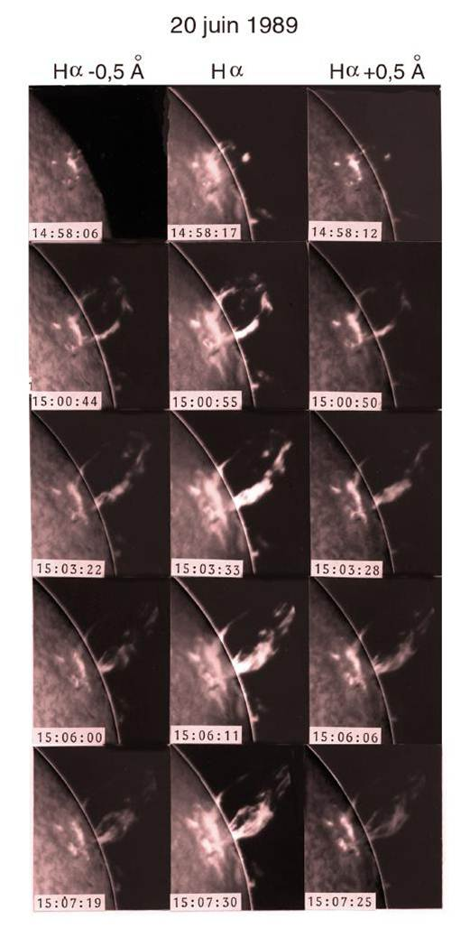
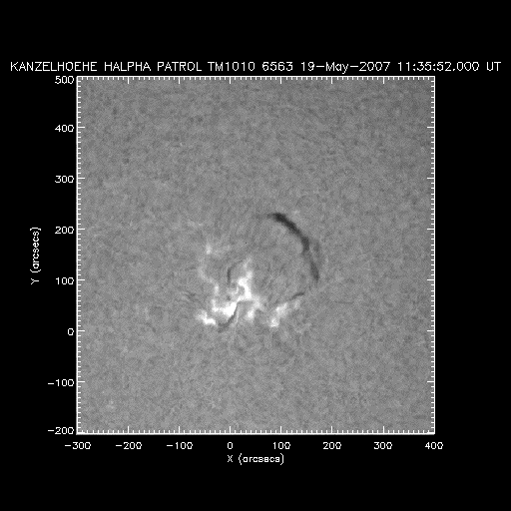
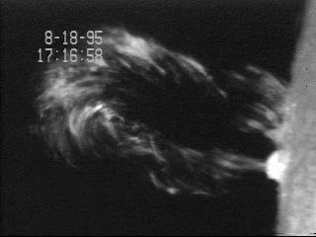
SW product 2: Filament eruptions
Real-time: alerts, ejections & disappearances, location, timing
Diagnostics: filament activation, dynamics, precursors (flows, swelling)
CME association: flux rope topology and orientation
BBSO, 18/8/1995
Obs. Kanzelhöhe, 19/5/2007
Obs. Paris-Meudon

Slide 6
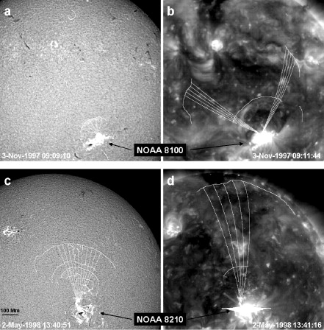
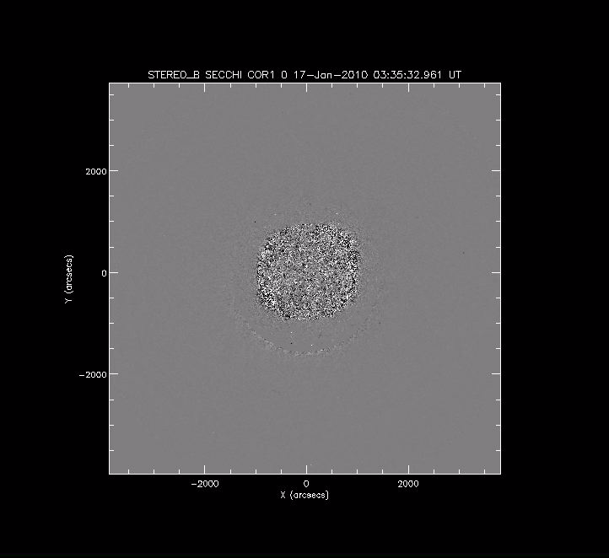
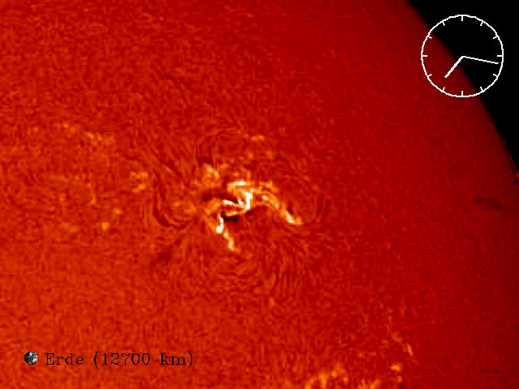
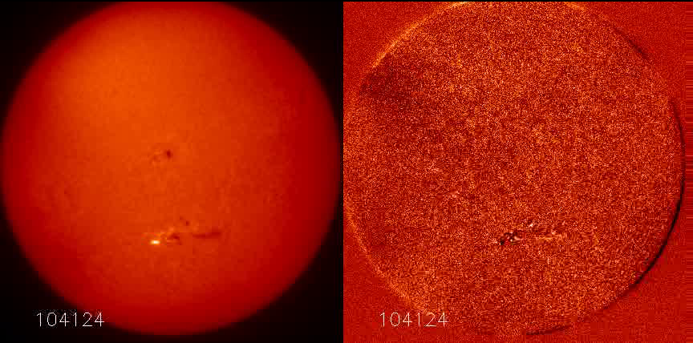
SW product 3: Moreton waves versus coronal waves
Real -time: alert, source event location
Diagnostics: speed asymmetry of propagation, secondary events (filament destabilization, sympathetic flares)
Connection to the coronal EUV wave and CME
Eto et al. 2002,
Obs. Kanzelhöhe,17/1/2005
Obs. Paris-Meudon

Slide 7
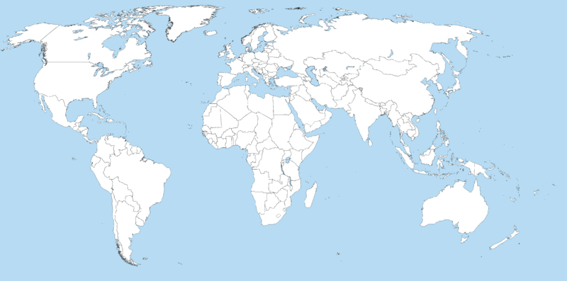
What is currently lacking ?
Chromospheric data are lagging behind
coronal data and operational SW products
Limited number of stations: ~8 stations in the world providing real-time images, most uncoordinated
  Uneven daily coverage (no global coordination)
  Data gaps due to day-night cycle and weather
CHAIN
ISOON/USAF
BBSO
Huairou
NSO/OSPAN
San Vito
Hida
Holloman
Mt. Chelia
Udaipur
Yunnan
HAO
Ramey
Ica
San Juan, HASTA
Culgoora
Learmonth
Antarctica

Slide 8
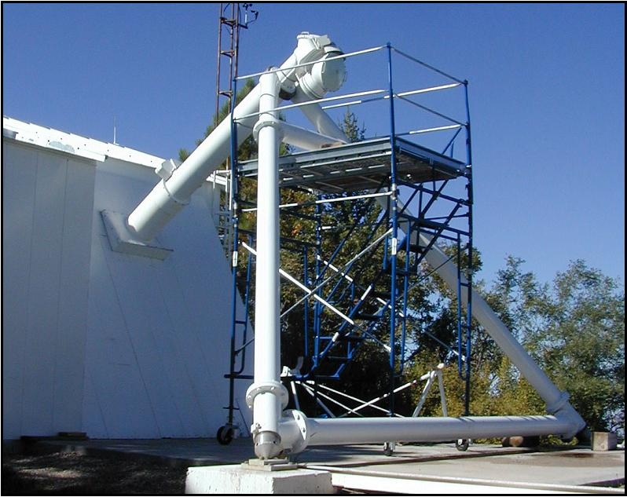
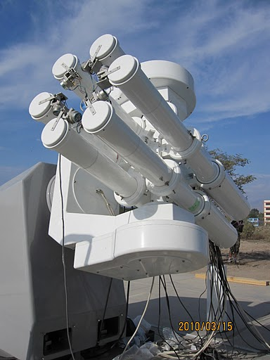
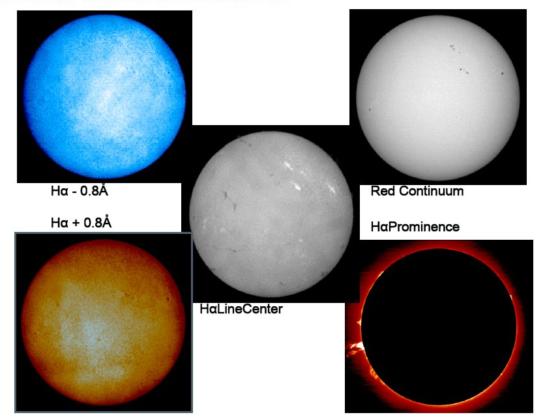

Networking projects outside Europe
ISOON (NSO/USAF):
  Only organized network
  4 stations
  No direct access to data
OSPAN: National Solar Observatory ( USA)
  Currently only 1 station
CHAIN/ Flare Monitoring Telescope (FMT): Hida Observatory (Japan)
  Under construction
  3 stations (+ Antarctica?)
OSPAN
FMT

Slide 9
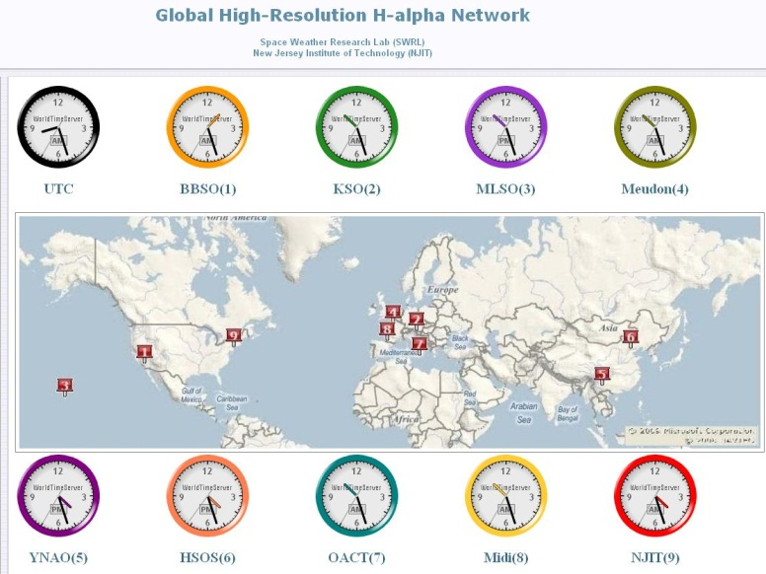
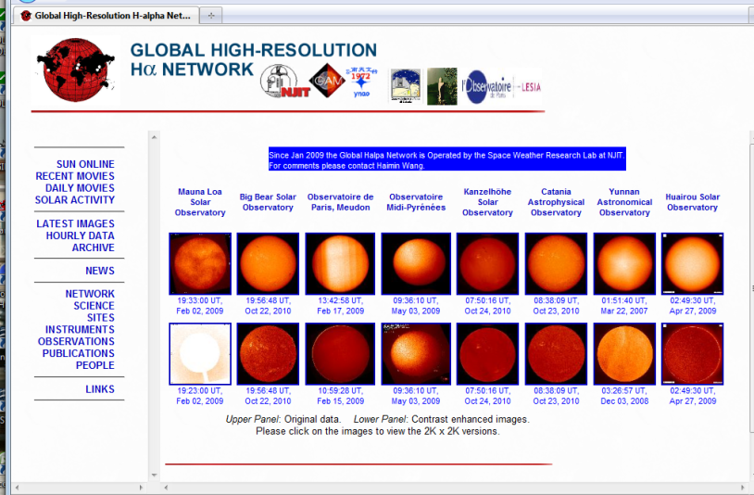
A single dedicated Hα portal
8 contributing stations (3 in Europe): daily raw synoptic images

Slide 10
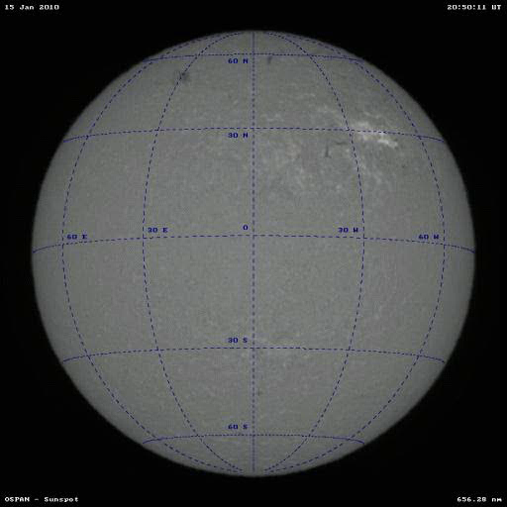
What is currently lacking ?
Lack of means and dedicated manpower
Basic synoptic operation modes > no continuous flare patrol
Limited equipment (no spares) > prone to failures disrupting service
No advanced image processing > mostly “raw” images
Lack of equipment standardization:
  spatial resolution, contrast
  different bandwidths (line center vs wings)
  random cadences and observing times
Sparse disconnected data series
No coordinated real-time operational products and alerts
SpaceW.com12/11/2010

Slide 11


HaSTeNet: a concept study
Prototype study phase
  Carried out by core stations (UC,KZ,CT,PM)
  Use of existing hardware and data
Design study of a new Hα imaging system
Implementation of a test-bed networked service:
  Image normalization and merging software
  Prototype data portal and alert services (flares, filament eruption)
Survey of additional European stations and worldwide collaborations
Survey of the user community and data products: needs versus feasibility
Instrument standardization: similar or identical hardware
Robust multi-station data production
« No dropout » architecture (continuity of service)
Integration into global European Space-Weather operational services (SSA)
Exploit strategic position of Europe in the field
  Potential for establishing world-wide standards for coming decades

Slide 12
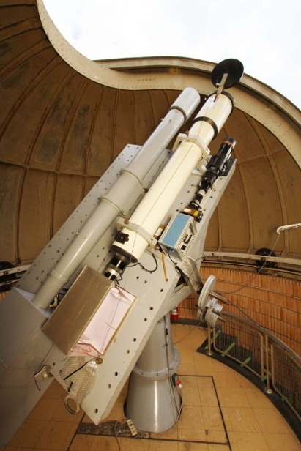
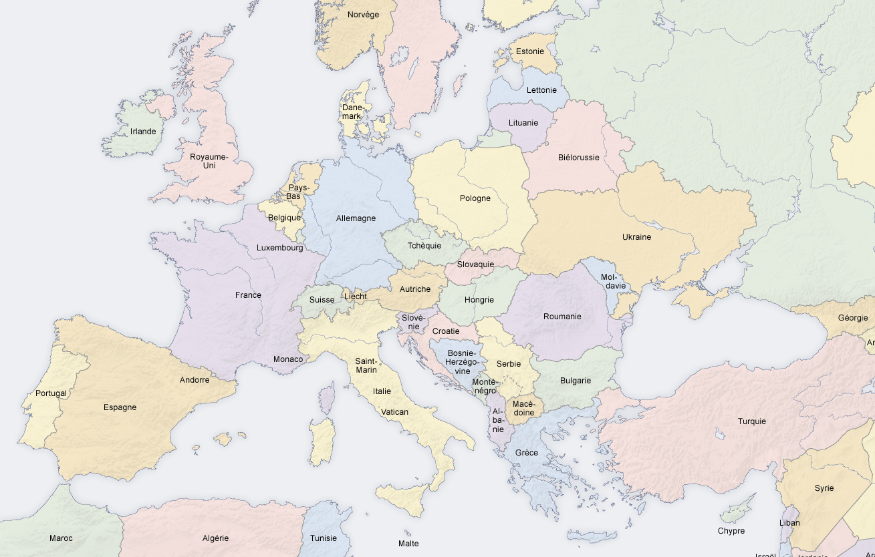
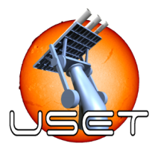
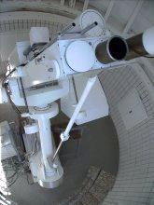

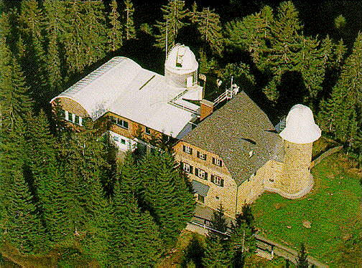
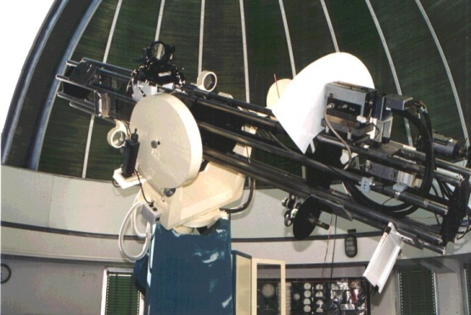
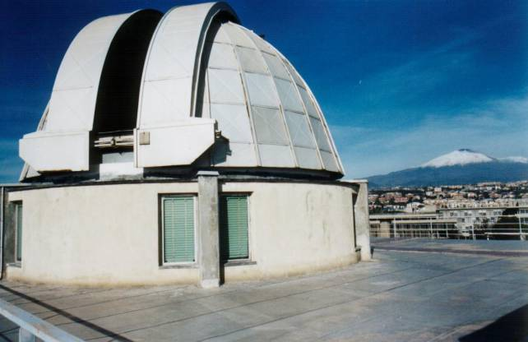
European assets: multiple well-distributed stations
Core group of stations in operation with past experience: Kanzelhöhe, Uccle, Catania, Paris-Meudon
Main observatories
NRT Web images
CCD capability
New instrument
+ Overseas: Canary Islands, Kourou, …
+ International collaborations: USA, India, China, Japan, Australia, …
Utrecht/DOT
Brussels
Wroclaw
Paris-Meudon
Ondrejov
Tatranska-Lomnica
Debrecen
Locarno
Kanzelhöhe
Bucarest
Coimbra
Pic-du-Midi
Rome
Hvar
Kandili
Athens
Catania

Slide 13
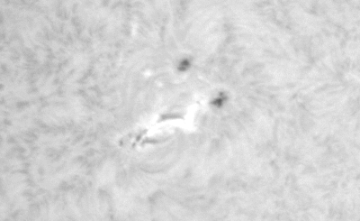
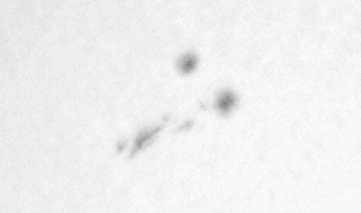
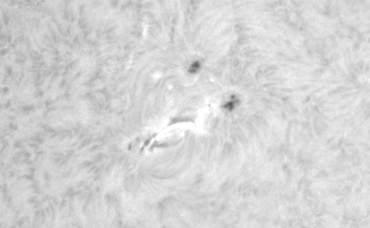
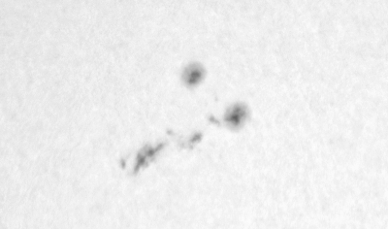
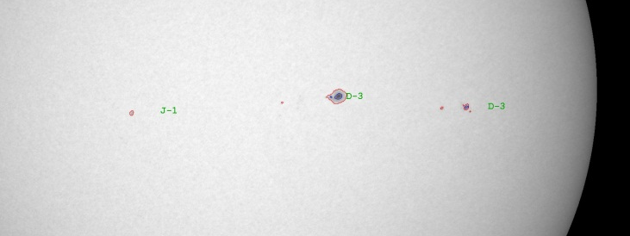
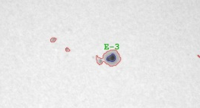

New Hα-specific software challenges
Atmospheric effect compensation:
  Transparency & refraction
  Seeing (destretching ?)
  Image normalization ( contrast, PSF compen- sation)
Multisource data merging
  Uneven time sampling
Other classes of events and features:
  Optically thick, sharp boundaries, smaller dimensions.
RT seeing compensation, (USET Brussels)
Raw
Optimized
High-definition Sunspot boundary extraction (Kanzelhöhe, Univ. Graz)
Cross fertilization + extension + fusion of know-how developed for space experiments (SoHO, STEREO, PROBA2, SDO)

Slide 14





European assets: image processing and databases
Many solar groups with expertise
in advanced solar image processing :
  SIDC-Brussels
  Paris-Meudon (BASS2000, HELIO)
  Bradford University
  Glasgow University
  Coimbra -UNINOVA/Hurbanovo (COSIS)
  Trinity College Dublin
in solar databases, data portals, virtual observatories:
  SIDC-Brussels (SoTerIA-SODA)
  MSSL (HELIO)
  Paris-Meudon (BASS2000)
  Kanzelhöhe (KEAS, CESAR)

Slide 15
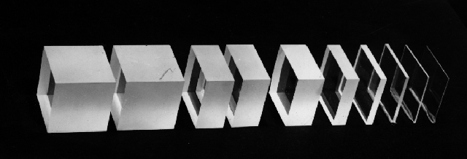
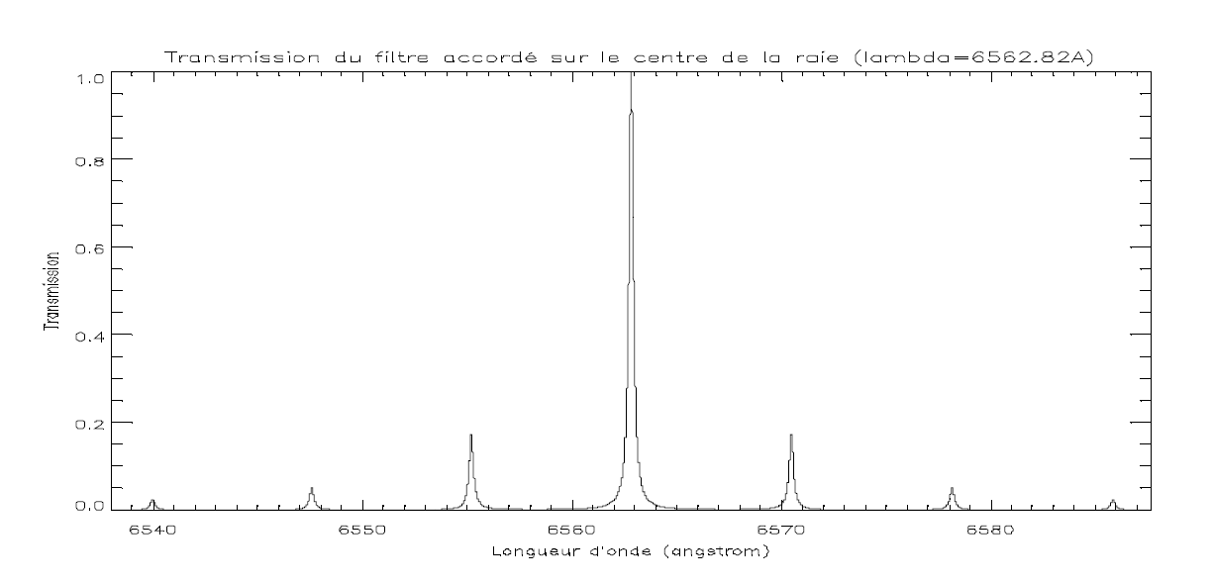
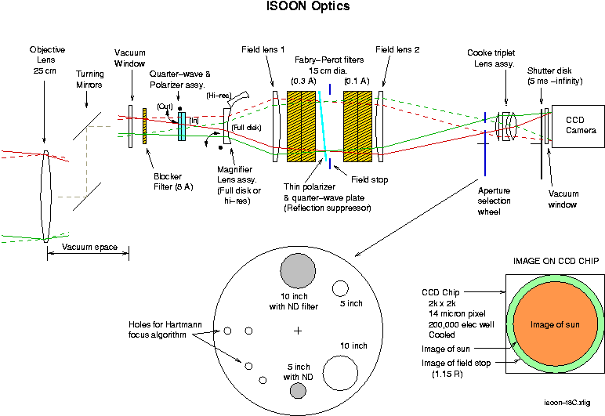
Multiple technical developments and challenges
Optics:
  Narrow bandpass (< 0.05 nm)
  Tunable etalons (birefringent or Fabry-Perot)
  Telecentric & multipath optics
  Narrow-band and heat rejection filters
Detectors:
  Cooled high dynamic range sensors (> 12 bits)
  High-cadence imaging (> 8 im/s)

Slide 16
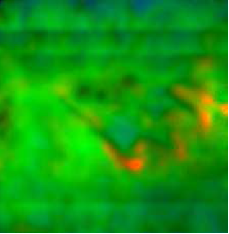
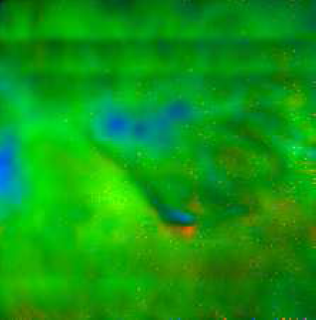
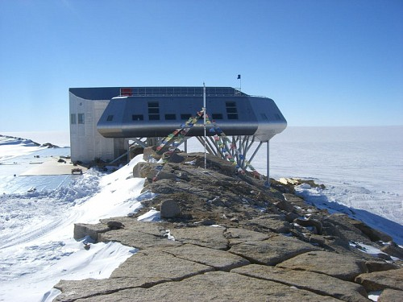

The next step: open issues for full deployment
HaSTeNet = preparation of the actual full deployment
  Construction & replication of state-of-the-art instrument
  Full network
  Full set of data products (continuous movies)
  Permanent integration into the SSA SW services
Key choices to be settled
Doppler speed measurement? (tunable wavelength)
Magnetograph mode? (birefringent system + polarizer)
Addition of two polar stations ?
  Possible synergy with current polar projects
  Antarctic (Belgium ?)
  Arctic (Norway/Svalbard ?)
V
B
Obs. Paris-Meudon

Slide 17
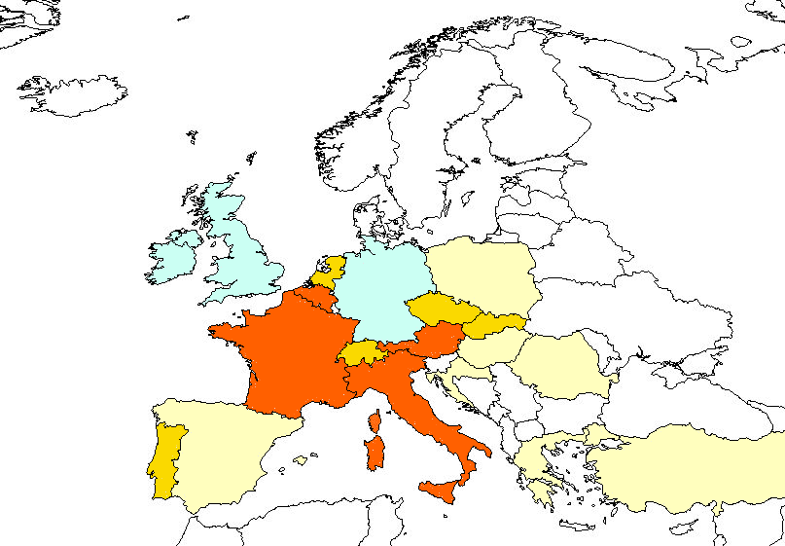
HaSteNet: an awaiting european potential
WANTED
Commitment from national delegations
Marks of interest from industrial partners
WANTED
Core countries
European poles of expertise in ground-based solar monitoring
Observatories
New telescopes
Data processing

Slide 18
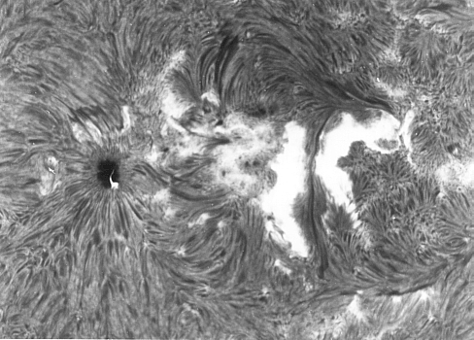
Conclusions
Key SSA segment
Robust SW service
Unique EU expertise
Hardware& software challenges
HaSTeNET
High return /cost
Synergy with space
Weak national commitments in spite of high potential
Contact us to know more and to join !

