Slide 1
Monitoring of auroral oval location and geomagnetic activity based on magnetic measurements from satellites in low Earth orbit.
S. Vennerstrom
Technical University of Denmark, Denmark (DTU)
SOTERIA collaboration

Slide 2
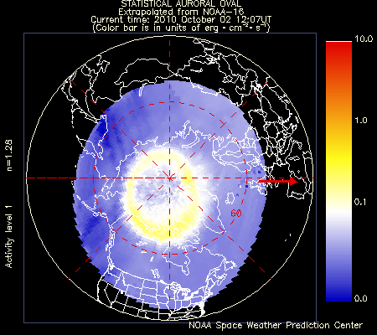
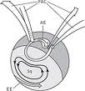
Auroral oval location – why bother?
Ground Induced Currents (auroral electrojets)
Communication problems
Increased radiation dose in LEO (energetic electrons)
Correlated with cut-off latitude of SEPs
NOAA - POES
Particle precipitation
SSA
SSA
Magnetic field?
?

Slide 3
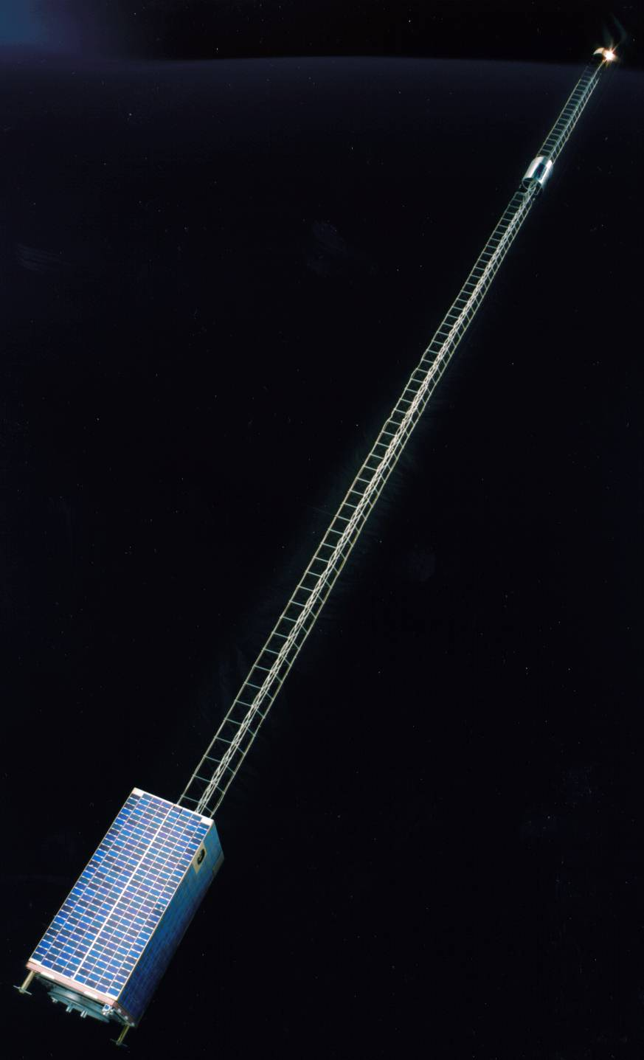
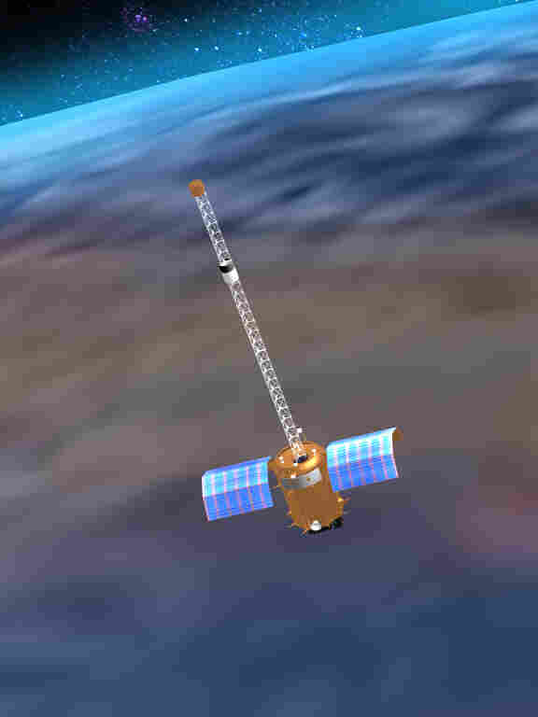
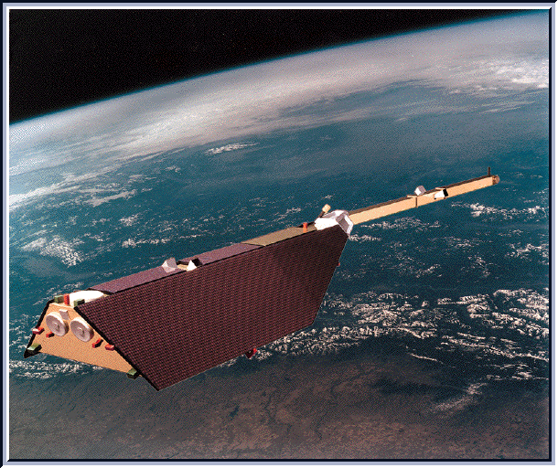
Current low altitude, polar orbiting, high precision magnetic field missions
CHAMP
2000 -2010
Ørsted 2/SAC C
2000-2004
Ørsted
1999 - ?
2004
These data can be used to derive electrojet location during passage

Slide 4
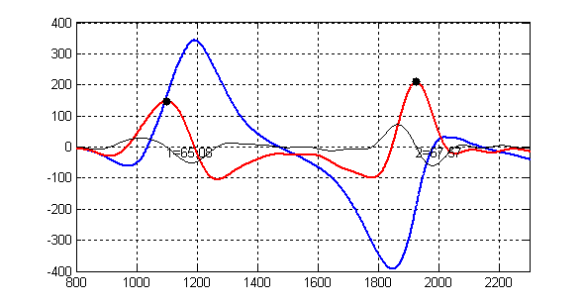
Method –
CHAMP passing the polar region
Babs (residual) (blue),
Babs/Δx (red)
2004

Slide 5
Eastward and westward auroral electrojets
Northern and Southern hemisphere

Slide 6
Electrojet position and intensity statistical Kp dependance

Slide 7
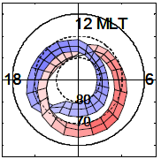
Comparison to ABI and AL
Dst
latitude
CHAMP
AL
2004

Slide 8
Comparison to AU and AL
CHAMP
2004

Slide 9
April 2002
Boundary: b2e
2004
Boundary b2e: Maximum average energy of precipitating electrons

Slide 10
Comparison to acceleration boundaries (discrete aurora)
Boundaries: b3a and b3b
Boundary b3a and b3b: Poleward and equatorward boundary of acceleration events

Slide 11
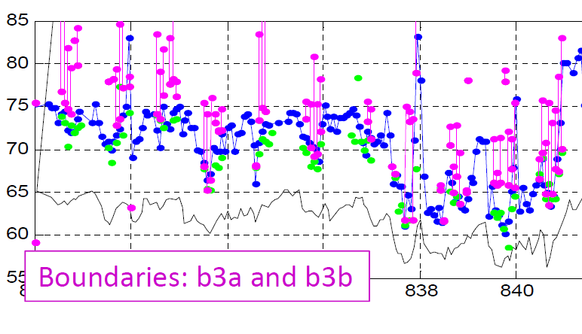
Close association even in details!
2004
Small changes from one orbit to the next are not noise!

Slide 12
Dst - observed from satellite
2004

Slide 13
Summary
Satellite magnetic field intensity measurements in polar low Earth orbit can be very useful for space weather monitoring
The latitude of the auroral electrojets is well determined by the satellite B-field intensity data. It coincides with the b2e electron precipitation boundary (max electron energy), and the equatorward boundary of the discrete auroral precipitation.
The magnetic data can provide a measure of electrojet intensity well correlated with AL and AU and a measure of the ring current intensity well correlated with Dst

Slide 14
Extras

Slide 15
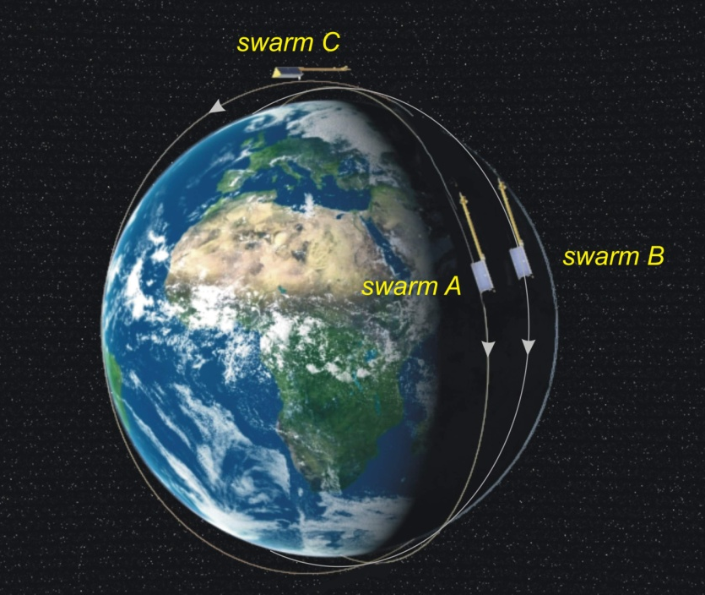
The Swarm mission
Constellation
3 satellites:
A+B: 2 side-by-side in low orbit, Δφ=1.5°
C: 1 in higher orbit
A+B staying together
A+B and C Slowly drifting apart in LT
Based on Swarm we can create a European counterpart to the US auroral oval monitoring
Notes:
Presentation of the Swarm mission
Launch, orbits, lifetime
-Animation

Slide 16
Measurement requirements
Auroral electrojet location:
Accuracy: 1 nT?
Blå kurve: Forstyrrelse af Babs
Grøn: dBabs/dlat
Rød: dBabs/dlat filtreret=max viser
positionen af electrojet’en

Slide 17
Satellite: low lat. ΔB

Slide 18
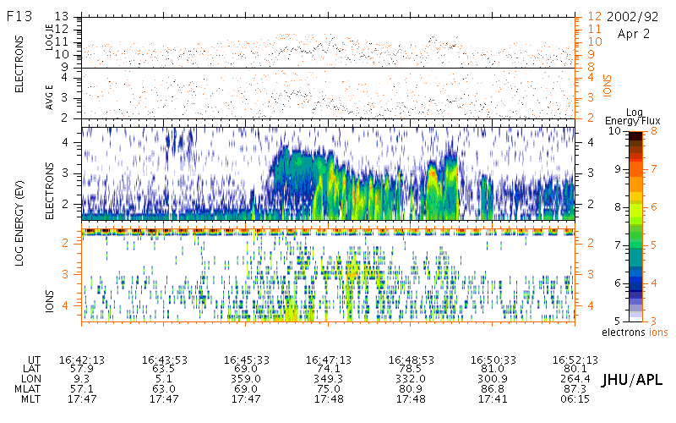
Automatic b2e detection fail

Slide 19
IMF By dependence

Slide 20
Magnetic disturbances - Two approaches
Using B-field vector-data:
  Inversion of high latitude electrodynamic parameters: FAC strength and location, polar cap potential, Joule heating
  Requires continous data (CHAMP, some Ørsted events)+ E-field or conductance (Swarm)
Using only data on B-field intensity
  Estimate location and intensity of ionospheric electrojets
  Continous data from at least 3 satellites available (less challenging for future missions)
This presentation

