Slide 1


Creating an SEP flux database from ESA/SREM measurements
I. Sandberg, I.A. Daglis and A. Anastasiadis
Space Research and Technology Group
Institute for Space Applications and Remote Sensing
National Observatory of Athens, Greece
P. Nieminen and E. Daly
Space Environments and Effects Section
European Space Agency, ESTEC, Netherlands
Extension of the activity: ESA contract number 21480/08/NL/NR

Slide 2
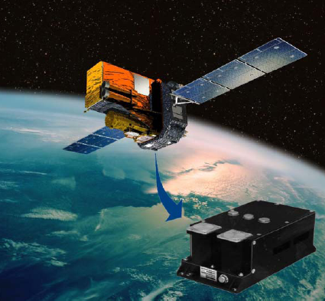
Introduction
Goal
The creation of a new proton and energy solar energetic particle flux database based on the measurements of the Standard Radiation Environment Monitor of ESA.
Outline of this talk
The Standard Radiation Environment Monitor of ESA
Calculation of SEP fluxes from SREM counts
SREM/SEP flux database

Slide 3
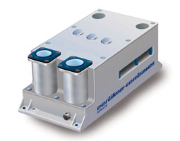
SREM: Standard Radiation Environment Monitor
Charged particle detector based on three solid state Si crystals
Mass: 2.5 kg, Dimensions: 96x122x217 mm3, Power: < 2W
Manufactured by OERLIKON- CONTRAVES (RUAF Space)
in cooperation with PSI and ESA; 10 units
Detects high-energy charged particles: e⁻ E_{e}>1 MeV, p⁺: E_{p}>10 MeV
Monitors spacecraft radiation environment
Provides functions related to space weather hazards
for the host spacecraft and its payload
Provides data associated to various physical processes

Slide 4
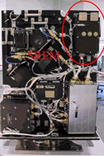
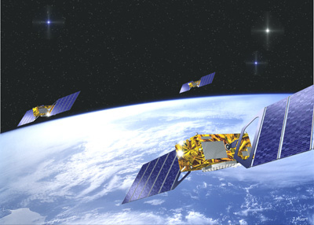
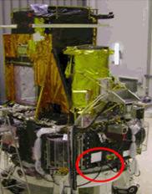
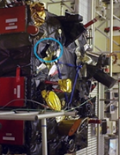
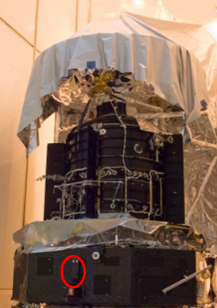
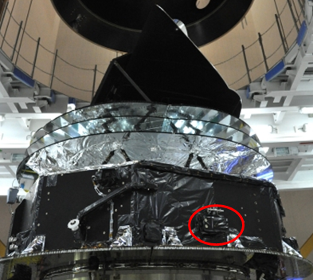
SREM missions
Mission | Data | Orbit
PROBA1 INTEGRAL Rosetta Herschel Planck GIOVE-B | 2001-11 2002-11 2004-11 2009-06 2009-06 2008-06 | LEO (sun synchronous) HEO (highly eccentric) Interplanetary L2 L2 MEO (near-circular)
GIOVE-B
PROBA-1
INTEGRAL
ROSETTA
HERSCHEL
PLANCK

Slide 5
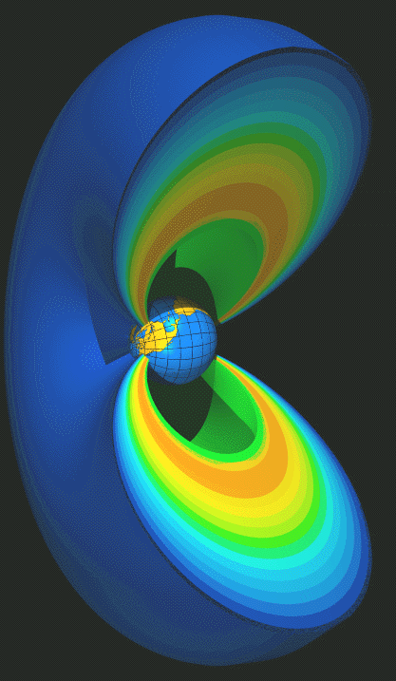
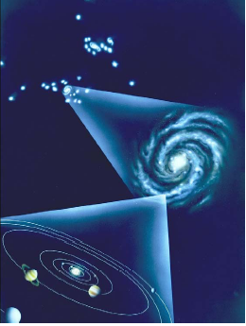
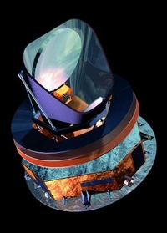
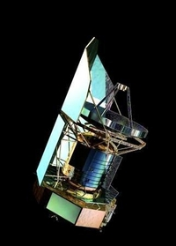
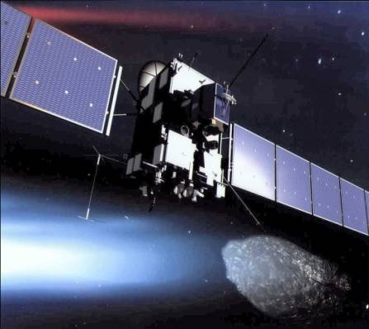
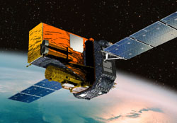
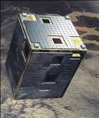
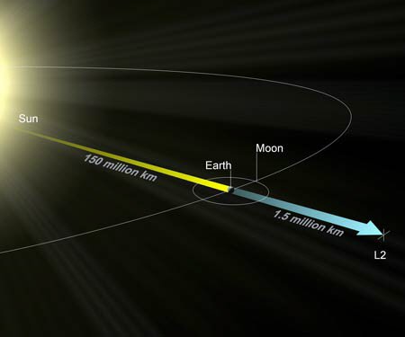
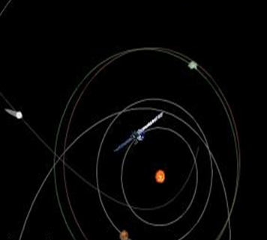
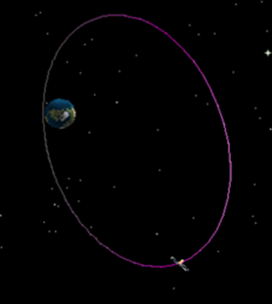
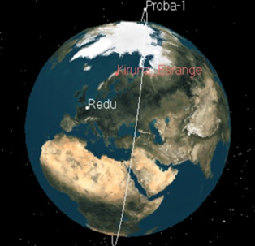
Multiple measurements from identical units
Radiation Belts Solar Particle Events Cosmic Rays
Sources
Missions
Orbits

Slide 6
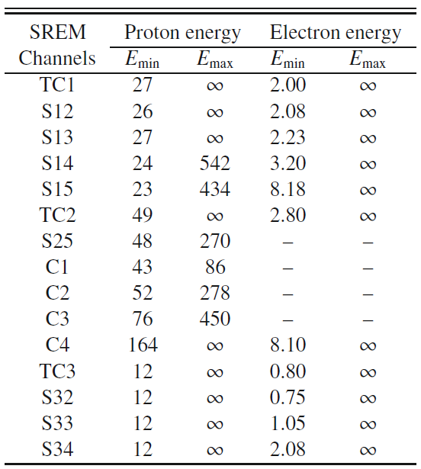
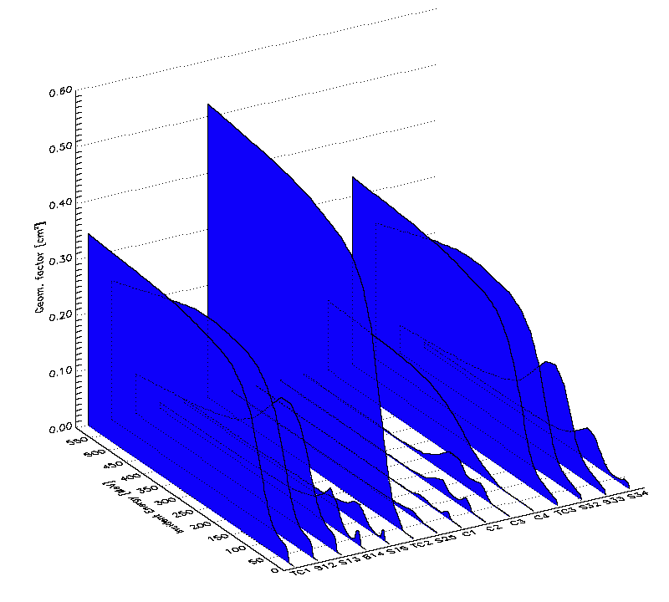
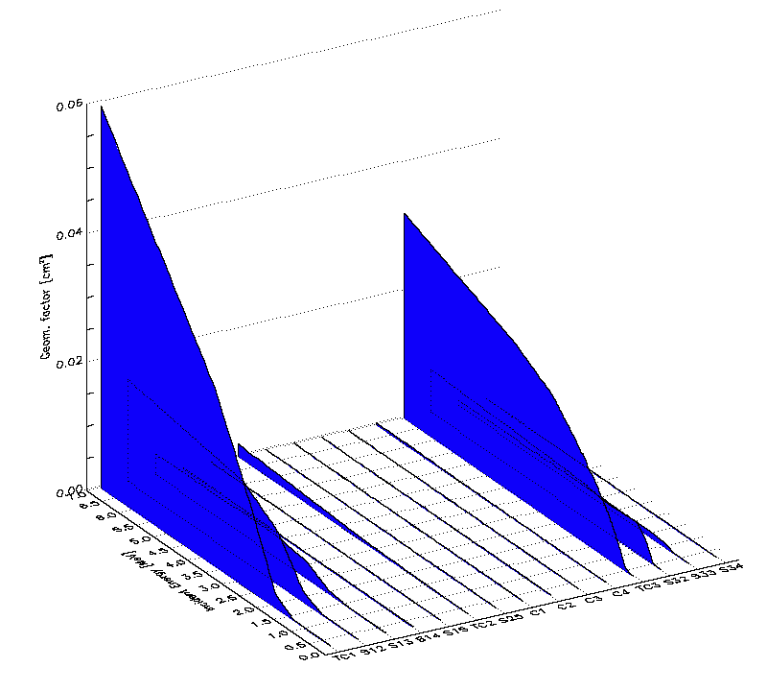
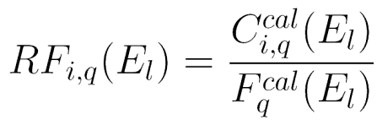
SREM data
Pre-amplified pulses are scrutinized and registered in 15 counters

Slide 7
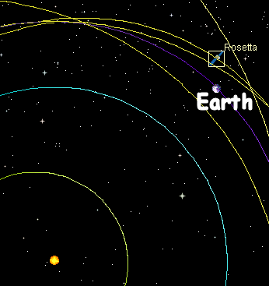
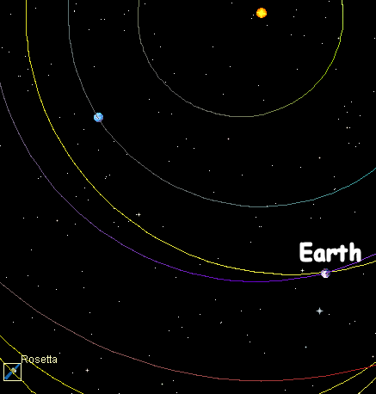
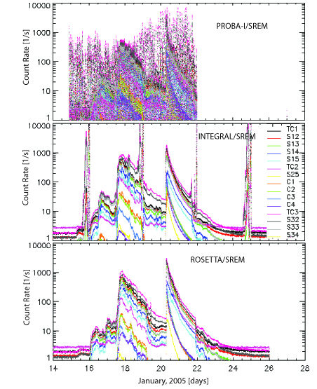
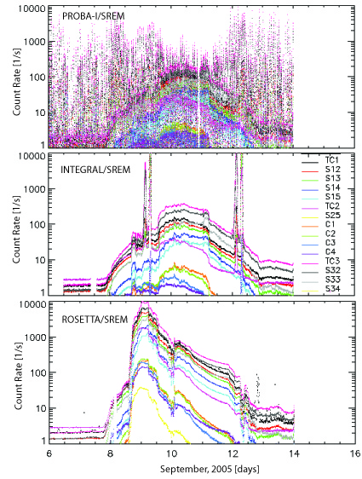
January and September 2005 SEP events

Slide 8
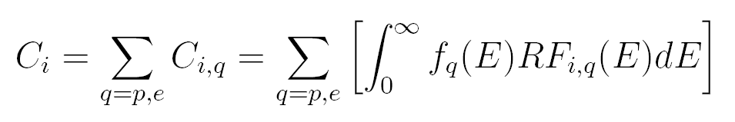
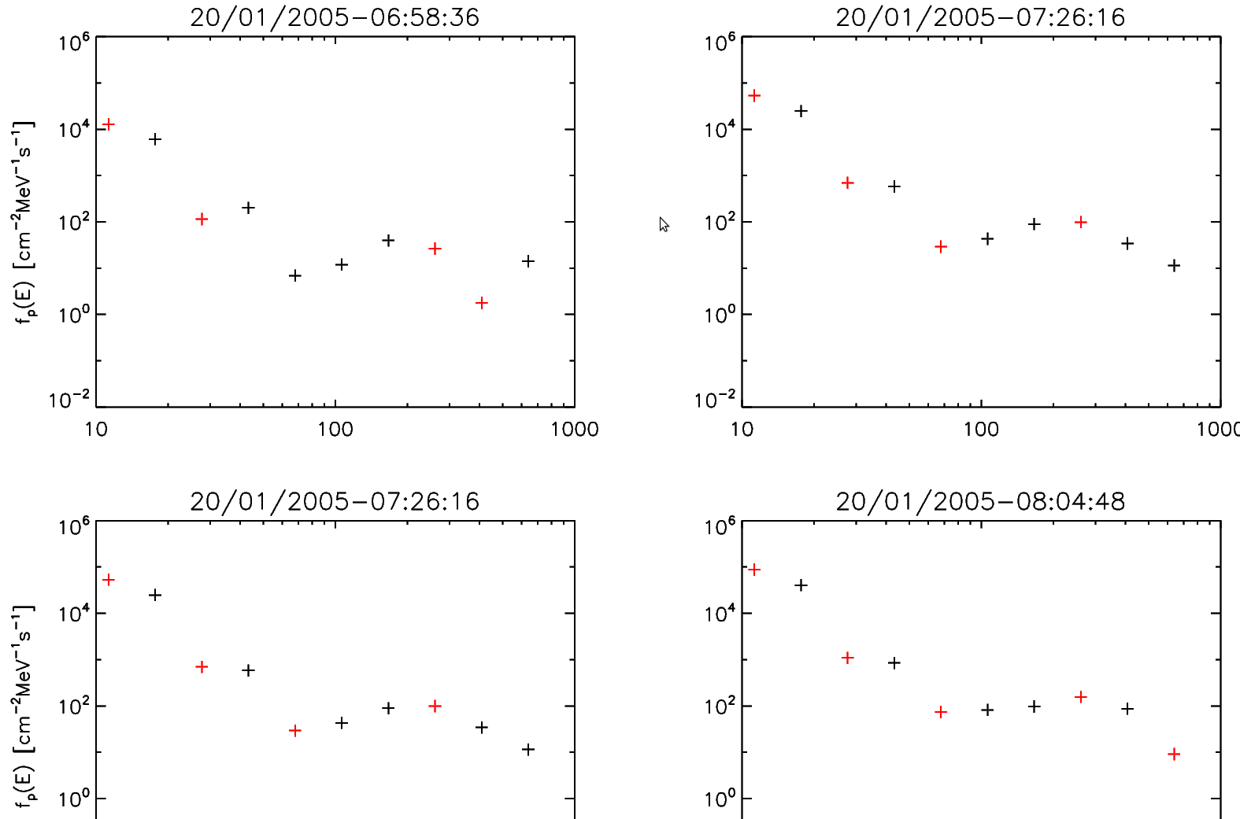

Counts to Flux Conversion: An inversion problem
Fredholm integral equation of the first kind: Ill-posed problem
The numerical solution is widely oscillating
    finite spectral resolution / calibration errors
    random fluctuations in measurements
    degenerated response matrix
    contamination effects
+ f_{p}(E)<0
+ f_{p}(E)>0

Slide 9
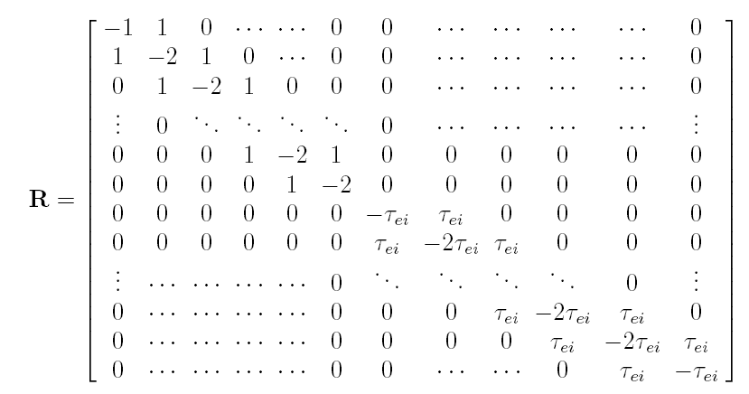
Solve a regularized system!
Tikhonov regularization:
Regularization parameter: τ
Singular Value Decomposition
Regularized fluxes:
Höcker A. and Kartvelishvili V., Nucl. Inst. Phys. Res. A 372, 1996

Slide 10
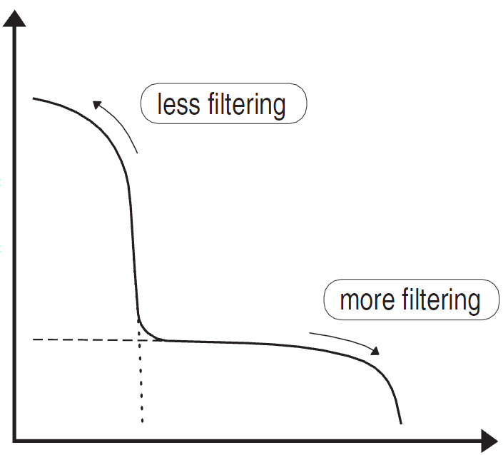
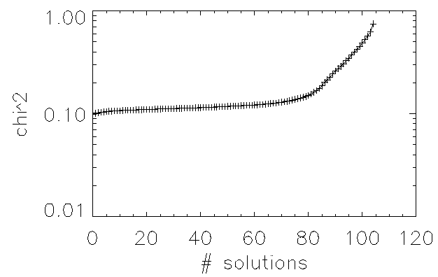
Optimize flux estimators
Selection of the regularization parameter
L-curve method: plot the smoothing norm
versus the residual norm for the candidate values of the regularization parameter and chose τ from the point of highest curvature.
(Hansen, SIAM J. Sci. Computing, 1993)
Selection of SREM counters
SREM counters have strongly overlapping energy ranges
For N_{b}<15 counters there are
different combinations and solutions one can get!

Slide 11
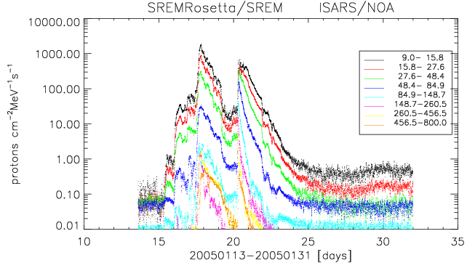
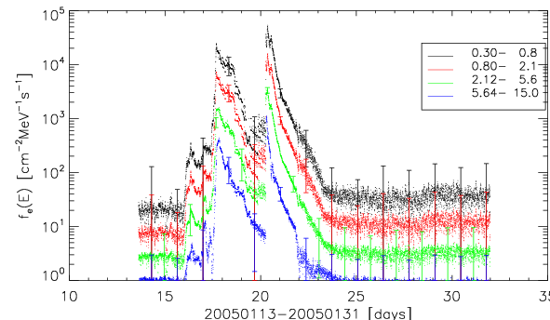
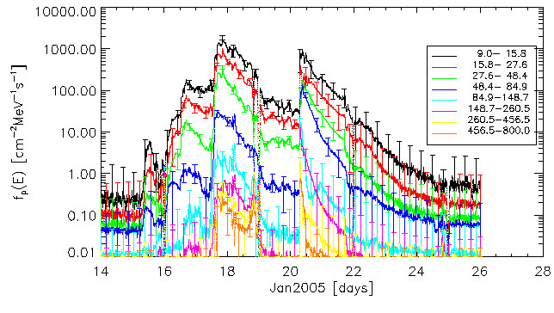
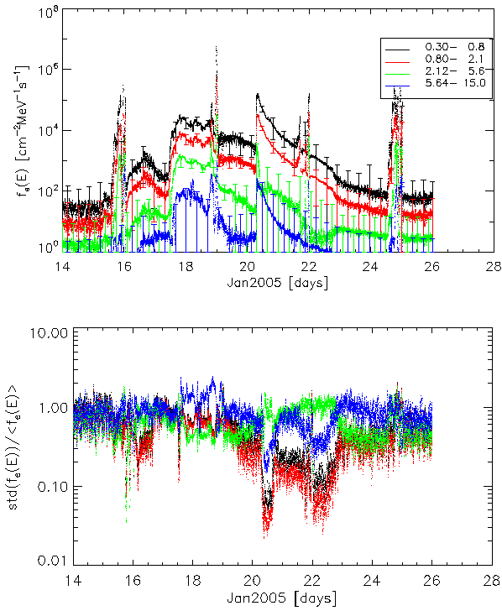
SREM fluxes during January 2005 SEP events
Protons
Electrons
Rosetta/SREM
INTEGRAL/SREM

Slide 12
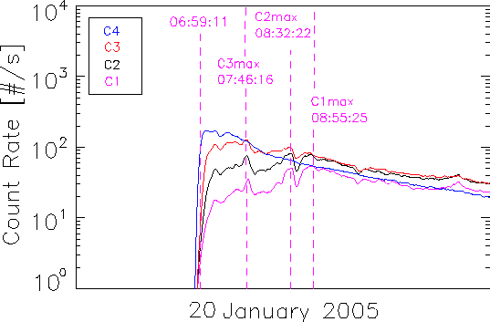
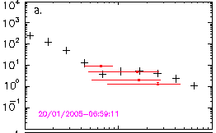



Comparison with other methods
Unfolded count-rates have been successfully compared with fluxes derived using:
The simple conversion factor coefficients (H.D.R. Evans et al Adv Sp Res, 2008)
Standard minimization methods for given spectral form:
The application of the developed method on SREM data:
Provides flux spectra with significantly increased resolution
Is much faster than standard minimization techniques.

Slide 13
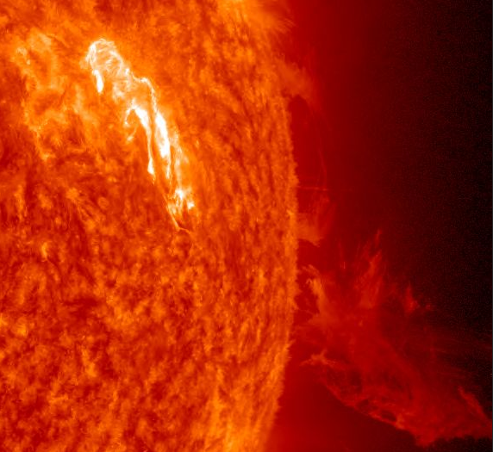
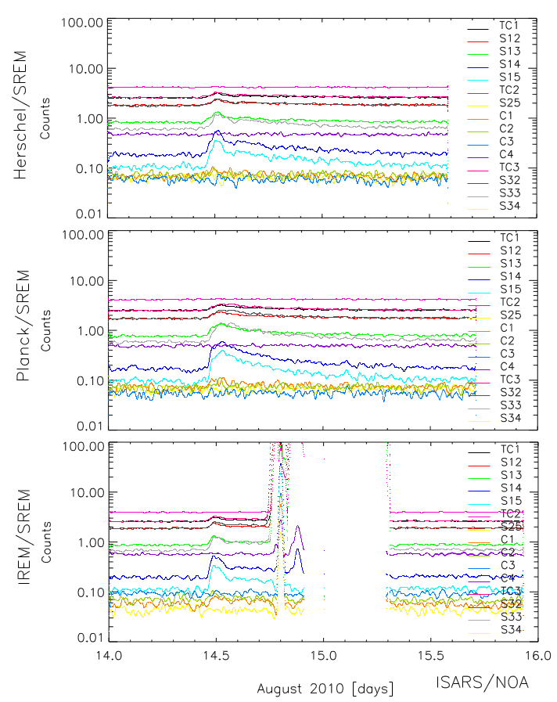
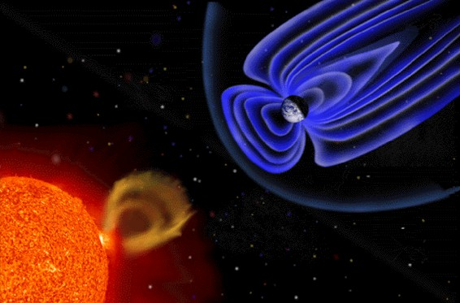
August 14, 2010: First proton solar event of Solar Cycle 24
C4.4 Flare
2010-08-14
Start: 09:38:00
Peak: 10:05:00
End: 10:31:00
Location: N17 W52

Slide 14
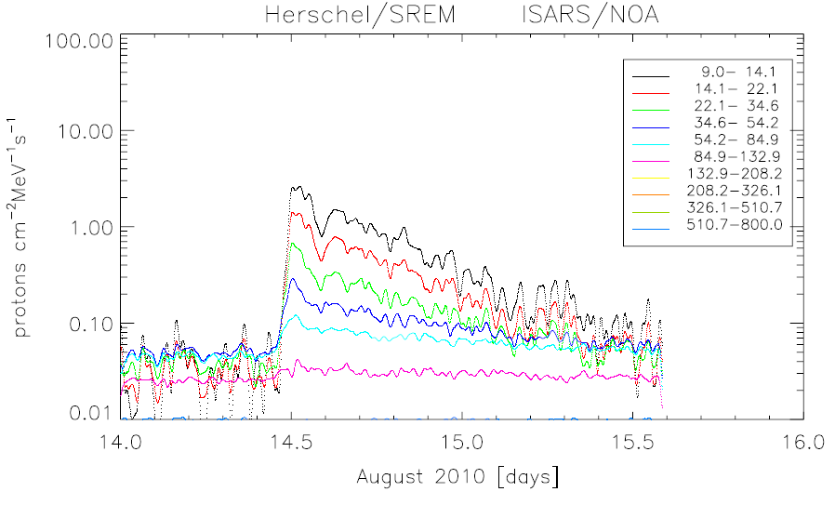
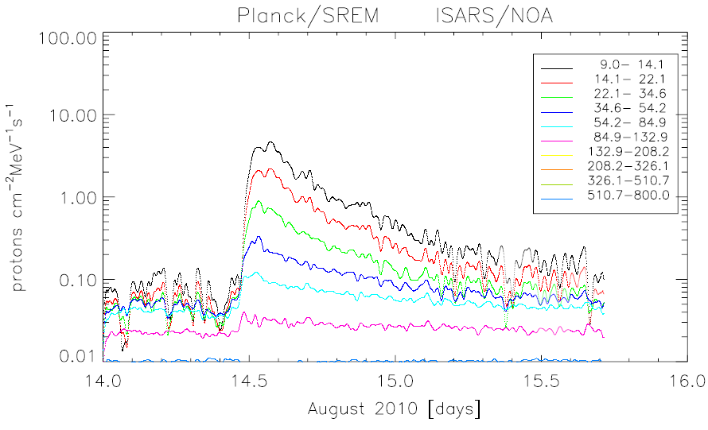
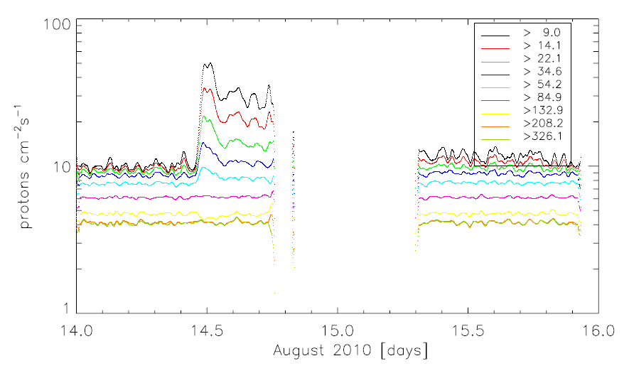
August 14, 2010: SREM Proton fluxes

Slide 15
Towards the construction of an SREM/SPE flux database
Optimization of the ISARS-developed, SVD-based unfolding method
Incorporate refined response functions¹
Benchmark selected events with SEPEM² “standard” event dataset
Application of the derived fluxes for host spacecraft radiation
effects calculations (notably Rosetta solar cell efficiency)
Apply a “standard” definition of SEP event and create a SREM flux
database (latest and current solar cycle) using data from units
on-board INTEGRAL, Rosetta, Herschel and Planck
MySQL database in accordance to Open Data Interface³
¹ Space-IT, Switzerland, Laurent Desorgher
² SEPEM application server: http://dev.sepem.oma.be/index.php
³ ODI project: http://www.lund.irf.se/odi/

Slide 16
THANK YOU

