Slide 2
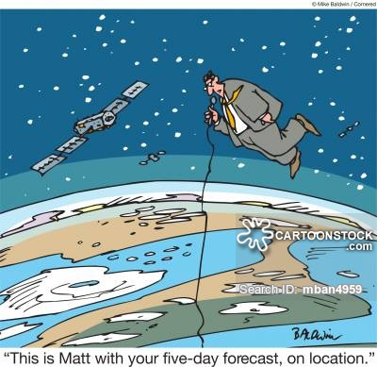
5th part
What does an operator of the space weather bureau have to do when space weather gets crazy? Which procedures should be followed? How are the data you need presented? Where to find and how will you get this data?

Slide 3
Short Rehearsal
Advisories + Concept of Operations + EGs
PECASUS live

Slide 4

Impact on technology
Nevertheless, our technology is impacted. PECASUS concerns impacts on aviation operations.
Radiation
effects
HF COM effects
GNSS
effects
Notes:
Monitoring & forecasting space weather should result in 3 advisory messages.
NOTAM = NOtice To AirMen
Radiation exposure at flight levels
High Frequency radio communication
GNSS-based navigation and surveillance
Note: for geomagnetic storm
If an event were strong enough to produce moderate degradation in the equatorial regions, it would likely be severe in the middle and high regions. In this case, there would be two advisories issued, one for the severe event affecting HNH, HSN, MNH and MSH and a second advisory for the moderate event affecting EQN and EQS.
Note for Radiation storm
Solar radiation may be severe above a certain altitude and moderate below. This requires 2 advisories.

Slide 5
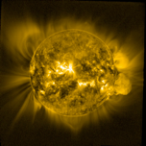
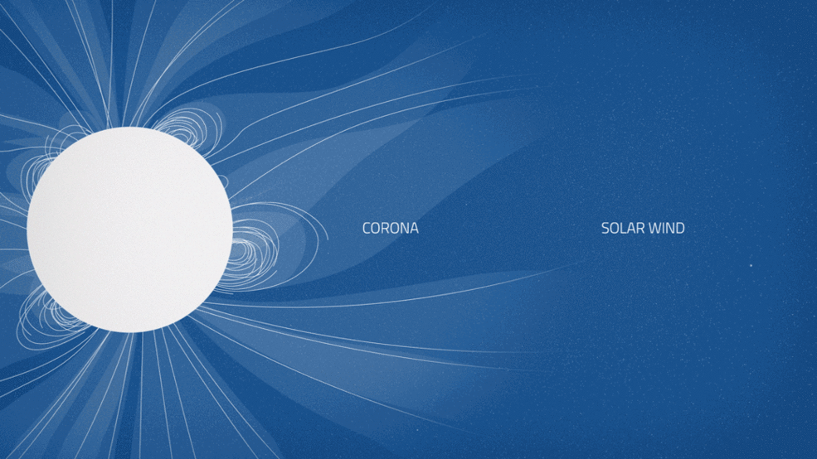
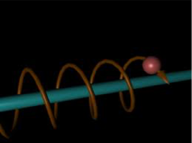

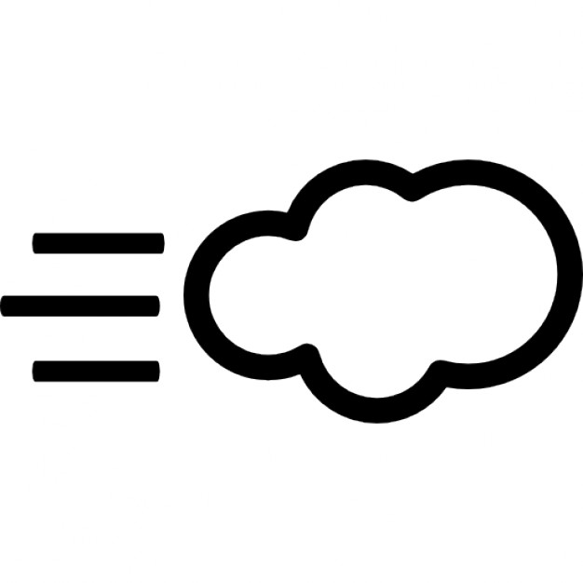

Sun looses energy
E.M. RADIATION
SOLAR WIND
ACCELERATED
PARTICLES
Notes:
TSI, e.m. radiation is not linked to the IMF. It doesn’t follow the magnetic field lines.
PROBA2/SWAP, the sun in the EUV
However, plasma containing ions and electrons has to follow the magnetic field lines. Or you can also say that the magnetic field lines guide the plasma.
The solar wind plasma is glued to the IMF - or the IMF is glued to the plasma.
The plasma in the solar wind is considered as a gas, a group of particles behaving and moving in group. You don’t speak about that particular particle in the solar wind, you speak about the solar wind, a whole bunch together.
Cartoon
Electrically charged particles have to follow the IMF. These electrically charged particles are considered as individuals and behave as individuals.
Cartoon
Near Earth, the IMF still controls the solar wind and its movement. Much much further away from the Sun, the IMF becomes very weak and doesn’t control the solar wind anymore. But, this is not important for us. At 1AU, the IMF influences the plasma and the plasma the IMF.
About the animated gif:
Conceptual animation (not to scale) showing the sun's corona and solar wind.
Credits: NASA's Goddard Space Flight Center/Lisa Poje
The solar wind is a continuous radial stream of solar plasma that leaves the sun and moves away from it. It fils the space between the planets with solar mass. The solar wind reaches the boundaries of the heliosphere, a magnetic shield around the Sun. In the heliosphere, the Sun sets the rules and you have solar weather. Outside the heliosphere, you have the rest of the galaxy. Earth is in the heliosphere.
A nice movie is found on
https://www.nasa.gov/feature/goddard/2016/images-from-sun-s-edge-reveal-origins-of-solar-wind
https://youtu.be/QYM2_ytkjQo

Slide 6
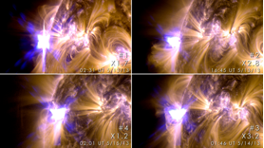
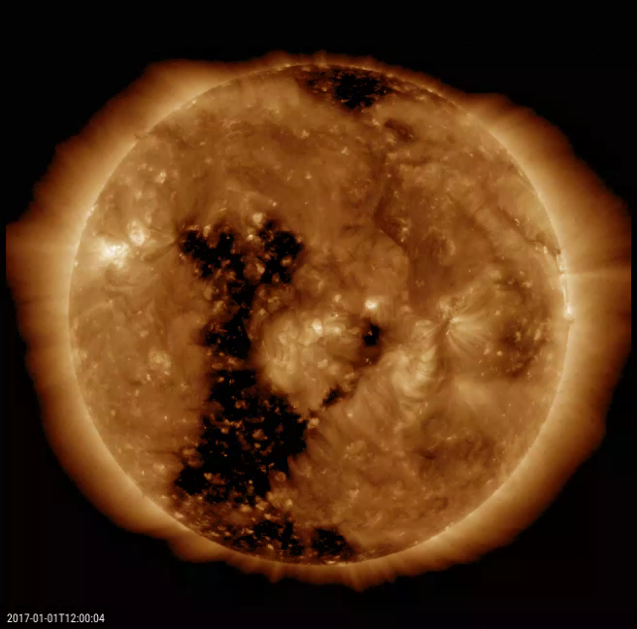
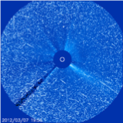
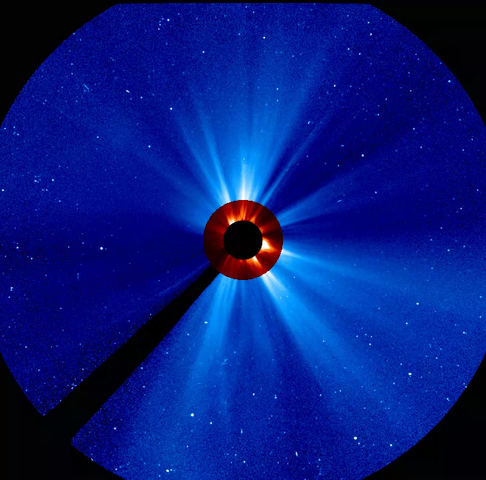
SPACE WEATHER
The sun expels continuously energy. We put the energy in 3 categories: e.m. radiation, solar wind flow of magnetised mass, particle radiation. Space weather concerns the (non-)eruptive energy releases that come on top of these continuous processes.
E.M. RADIATION
FLARE
SOLAR WIND
CME, CORONAL HOLE, SBC
PARTICLE RADIATION
SEP
Notes:
Magnetic reconnection triggers a sudden release of energy in the form of a flare, CME, particle event.
Space weather is the change that occur in the space environment.
A Flare is a sudden strong increase of the solar e.m. radiation. The light flash is localised on the solar surface.
SDO/AIA
A Coronal Mass Ejection is a plasma cloud that is ejected into space. You consider it as a cloud and not as a bunch of individual particles. It is superimposed on the background solar wind. You can see a CME as a complex magnetic bag with different magnetic layers with plasma in it that travels as a tsunami through space. It can go faster/as fast as/slower than the background solar wind. When it is faster, you will see a shock in front of the cloud. This is exactly the same as the shock you see in front of a speed boat.
A CME is visible as a white cloud in corona graphic images like the one on the slide. A coronagraph is a telescope that creates an artificial eclipse and makes pictures in the visible light of the region around the sun.
SOHO/LASCO C2 (red) and LASCO C3 (blue)
A coronal hole is a structure in the solar corona that you see as a black area in the EUV. It looks black because there is less plasma present that radiates in the EUV. The magnetic field lines are open, i.e. fan out into space. There are no magnetic loops above a coronal hole. The solar wind emanating from a CH is faster compared to the usual solar wind.
SDO/AIA
A particle storm is a bunch of electrically charged particles that circle around the IMF lines into space. They may impact telescopes. They are seen as white stripes and dots: this are particles that fall into the lens and blind the pixel(s). During that particular moment, the telescope can’t see anymore through the impacted pixels. You can say that the dots and stripes represent a sort of in situ measurement.
In situ means that you measure a parameter local. Remote sensing means that you look at something from a distance.
Near Earth, the IMF still controls the solar wind and its movement. If we would go much much further, the CME magnetic bag with solar plasma would be almost empty (all the solar material is spread over an immense volume) and the magnetic bag would have evaporated. But, this doesn’t matter for us. We are at 1AU and at 1AU the IMF and solar plasma make space weather in a normal way, in an extreme way.

Slide 7
SPACE WEATHER
The Earth and its environment reacts on these space weather events. The solar storms that impact earth are called ‘radio blackout’, ‘geomagnetic storm’ or ‘solar radiation storm’.
RADIO
BLACKOUT
GEOMAGNETIC
STORM
SOLAR RADIATION STORM
Notes:
Impact on Earth environment according to the NOAA space weather scales
Radio blackout
Impact on navigation & radio communication
Affects communications, and on rare occasions GNSS navigation.
Daylight side impact only.
May last from a few minutes to a few hours and are much shorter duration than geomagnetic storms.
Geomagnetic storm
Radio communication, HF and LF
Satellite operations
Power systems, e.g. GIC
Aurora
—> affect communication and GNSS navigation in the HNH and HSH regions and sometimes include MNH and MSH regions. EQN and EQS may be affected during the worst storms.
Solar radiation storm
Biological impact
Satellite operations
HF communication in the polar regions - degradation or black out (PCA)
Navigation

Slide 8
SPACE WEATHER
The sun expels continuously energy. We put the energy in 3 categories. Space weather concerns the (non-)eruptive energy releases that come on top of these continuous processes.
RADIO
BLACKOUT
CME
CORONAL HOLE
GEOMAGNETIC
STORM
SOLAR RADIATION STORM
Notes:
Impact on Earth environment according to the NOAA space weather scales
Radio blackout
Impact on navigation & radio communication
Affects communications, and on rare occasions GNSS navigation.
Daylight side impact only.
May last from a few minutes to a few hours and are much shorter duration than geomagnetic storms.
Geomagnetic storm
Radio communication, HF and LF
Satellite operations
Power systems, e.g. GIC
Aurora
—> affect communication and GNSS navigation in the HNH and HSH regions and sometimes include MNH and MSH regions. EQN and EQS may be affected during the worst storms.
Solar radiation storm
Biological impact
Satellite operations
HF communication in the polar regions - degradation or black out (PCA)
Navigation

Slide 9

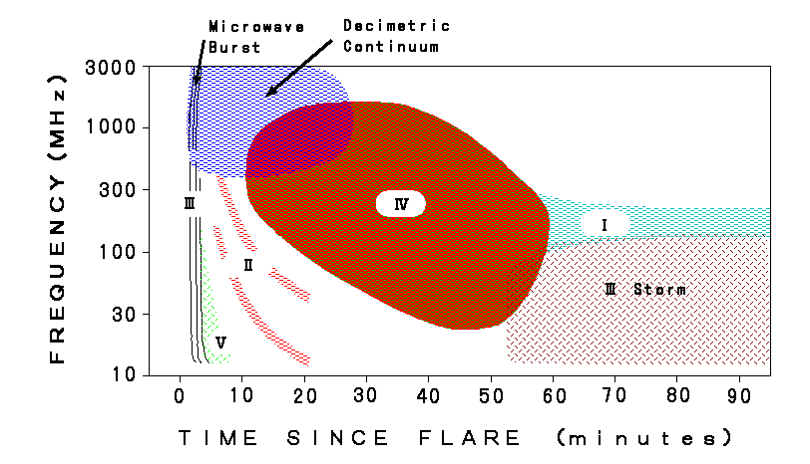
Solar radio bursts
SRB are produced by energetic electrons accelerated by solar eruptive events, like flares, filament eruptions, coronal mass ejections. Their radial signature - how it looks like in a spectrogram - tells something about the fate of these electrons.
!
!
Notes:
These bursts are triggered by a solar event.
Signature of presence of a CME, flare
******************
Detected by measuring e.m. waves in the radio wavelength
Type II, III and IV are important for space weather.
We can measure the solar e.m. radio output and put it into a spectrogram.
At low frequencies, 5 types of radio wave bursts are seen, each with a unique signature in frequency and time.
Mind the orientation of the vertical axis! Other figures may have a reversed direction. As the frequency is proportional to the square root of the density, and the density decreases with increasing distance from the Sun, a decreasing frequency means locations higher up in the solar atmosphere.
The ionospheric cut-off frequency is around 15MHz (due to too low frequency and so reflected by ionosphere). In order to observe radio disturbances below this frequency, one has to use satellites (above the earth atmosphere) such as STEREO/SWAVES or WIND. Radio bursts at low frequencies (< 15 MHz) are of particular interest because they are associated with energetic CMEs that travel far into the interplanetary (IP) medium and affect Earth’s space environment if Earth-directed. Low frequency radio emission needs to be observed from space because of the ionospheric cutoff.
Example: https://stereo-ssc.nascom.nasa.gov/browse/2017/01/16/insitu.shtml
Coronal Mass Ejections and solar radio emissions, N. Gopalswamy
http://citeseerx.ist.psu.edu/viewdoc/download?doi=10.1.1.708.626&rep=rep1&type=pdf
Gopalswamy: The three most relevant to space weather radio burst types are type II, III, and IV. Three types of low-frequency non-thermal radio bursts are associated with coronal mass ejections (CMEs): Type III bursts due to accelerated electrons propagating along open magnetic field lines, type II bursts due to electrons accelerated in shocks, and type IV bursts due to electrons trapped in post-eruption arcades behind CMEs.
[Radio burst type II, III, and IV are also the only ones that ever get mentioned in the Ursigrams. ]
**************
A type II burst is caused by a shock that triggers the local plasma to emit radio waves. While most of the interplanetary shocks are CME-driven, coronal shock waves can be attributed to solar flares, CMEs, or some combination of these two phenomena. Since the acceleration phase of the CME and the flare impulsive phase are usually closely synchronized, it is hard to distinguish between the flare energy-release effects and the CME expansion. Due to this problem the origin of the coronal shocks, i.e. metric type II bursts, still remains unresolved.
Type II
type II burst, slowly drifting, often with fundamental/2nd harmonic structure, due to plasma emission
cause is a shock wave, propagating at 500-2000 km/s outward into the corona into interplanetary space (also seen down to kilometric wavelengths).
Type III
◦ type III burst, rapidly drifting, often with fundamental/2nd harmonic structure, due to plasma emission. The fundamental is highly o-mode polarized, and the 2nd harmonic is weakly (15%) x-mode polarized.
▪ cause is a stream, or beam, of electrons moving at speed ~ c/3, propagating from low corona into interplanetary space (also seen down to kilometric wavelengths).
◦ type III storm -- a long lasting (up to a day or more) series of type III bursts, RS (reverse slope) bursts, reverse-drift pairs, and continuum.
Type IV
◦ stationary type IV -- broadband continuum emission, sometimes highly polarized, due to either plasma emission (o-mode polarized) or gyrosynchrotron emission (x-mode polarized).
▪ cause is a plasmoid or high, filled loops of non-thermal particles
◦ moving type IV -- a similar cause, but entrained in a CME or expanding arch.
Type V
◦ type V burst, continuum emission following a type III burst, x-mode polarized (opposite sense to the associated type III)
▪ cause is slower type III-like electrons in widely diverging magnetic fields, with both forward and counterstreaming langmuir waves, perhaps generated by previous passage of type III electrons.
linked with a solar event, like a flare, CME, languir waves

Slide 10

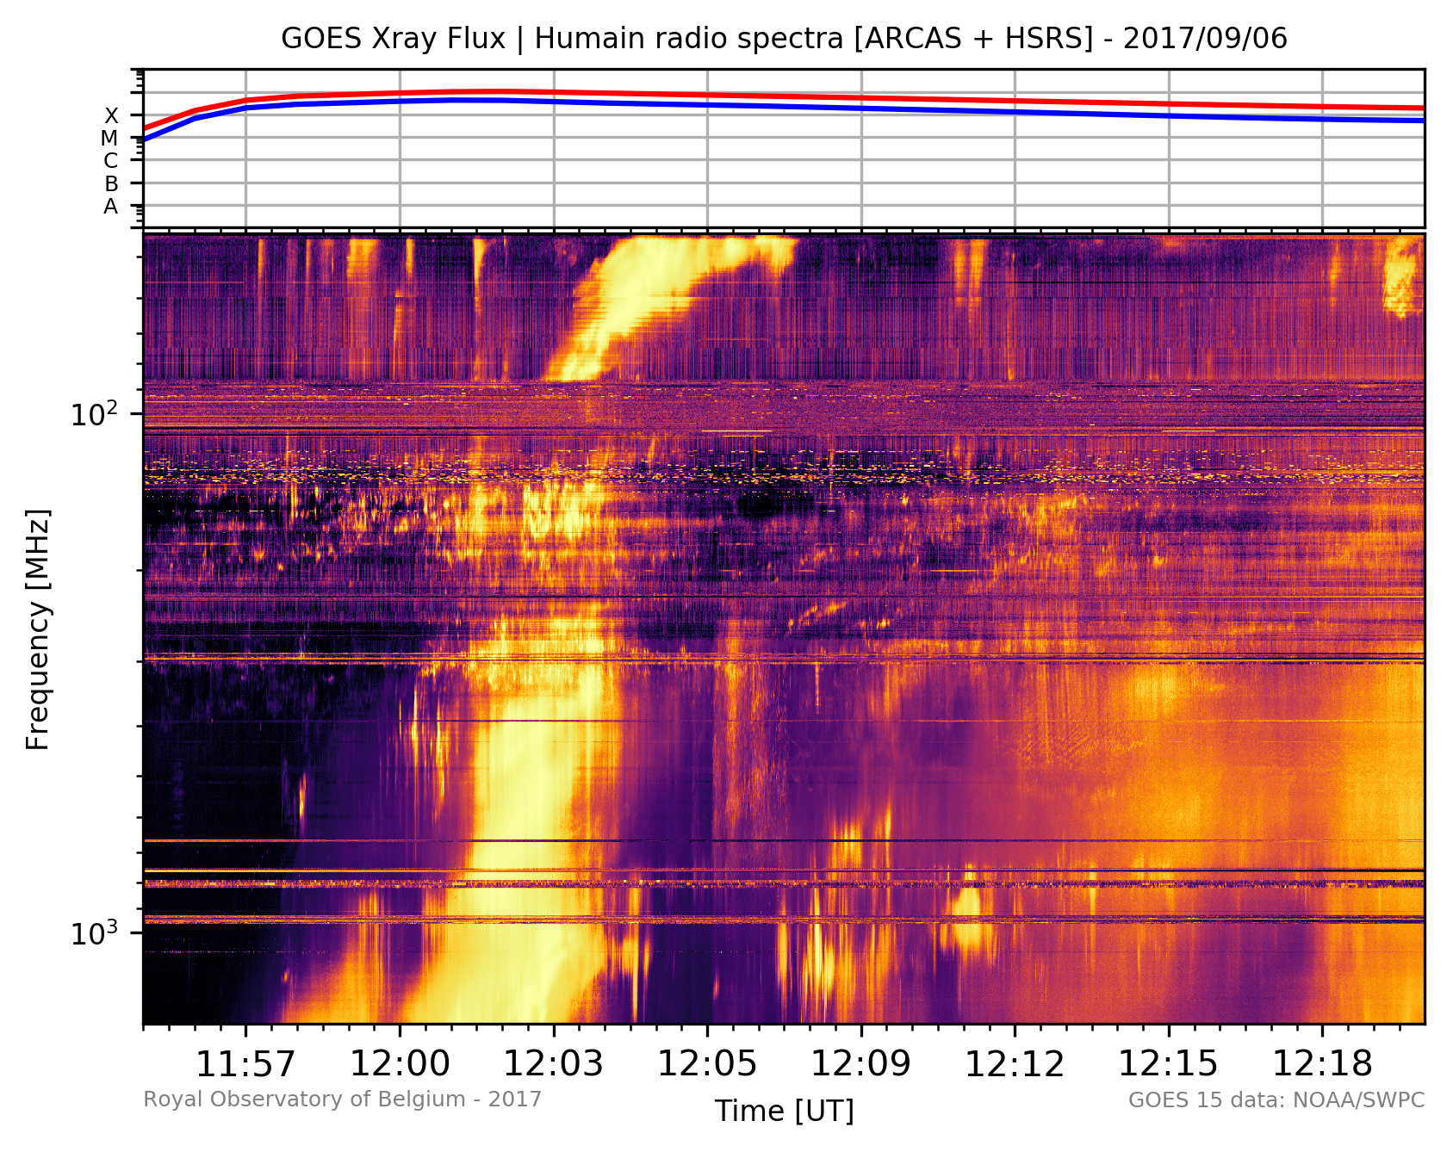
Solar radio bursts
We distinguish between 5 types of solar radio bursts. Not all types are present during an event.
•Type I: trapped in loops above A.R.
•Type II: accelerated by shock waves
•Type III: beams accelerated along open magnetic field lines
•Type IV: trapped in post-flare loops
Notes:
Signature of presence of a CME, flare

Slide 11
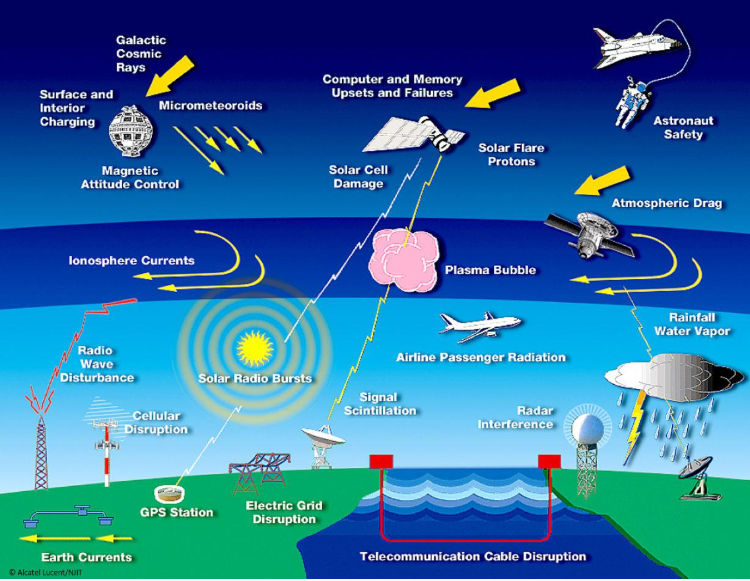
Notes:
Impact of SRB itself
GPS station
Signal/noise - signal is from the satellite. GPS receivers are designed to be sensible to the signal above them, not at the horizon.
When there is a strong radio burst - in the typical GPS frequencies - the noise increases.
GPS receiver ontvangt signalen die niet van een satelliet komen maar van de Zon. De GPS ontvanger maakt geen onderscheid tussen solar noise en satelliet signaal.
Radar interference
Radars are monitoring the planes near the horizon - descending and ascending planes
SRB can impact HF communication (no feedback from industry) and navigation

Slide 12
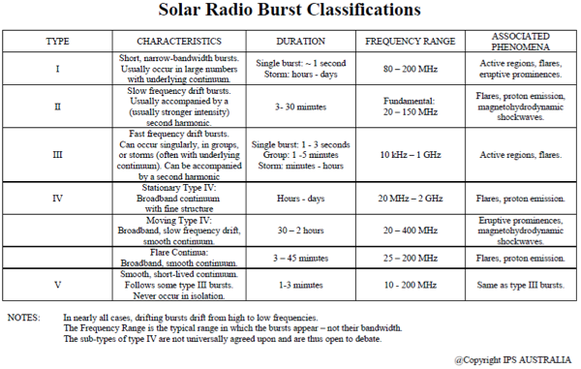
Notes:
Source - Table taken from the Australian SWS: http://www.sws.bom.gov.au/Category/World%20Data%20Centre/Data%20Display%20and%20Download/Spectrograph/Solar%20Radio%20Burst%20Classifications.pdf
From the SWPC’s “Solar Events” User guide (ftp://ftp.swpc.noaa.gov/pub/indices/events/README ):
RSP:
Type/Intensity
Type II: Slow drift burst
Type III: Fast drift burst
Type IV: Broadband smooth continuum burst
Type V: Brief continuum burst, generally associated with Type III bursts
Type VI: Series of Type III bursts over a period of 10 minutes or more, with no period longer than 30 minutes without activity
Type VII: Series of Type III and Type V bursts over a period of 10 minutes or more, with no period longer than 30 minutes without activity
Type CTM: Broadband, long-lived, decametric continuum
Solar Radio Bursts and Space Weather, S.M. White
https://www.nrao.edu/astrores/gbsrbs/Pubs/AJP_07.pdf
Type IV bursts are broadband quasi–continuum features associated with the decay phase of solar flares. They are attributed to electrons trapped in closed field lines in the post–flare arcades produced by flares; their presence implies ongoing acceleration somewhere in these arcades, possibly at the tops
of the loops in a “helmet–streamer” configuration. Type IV bursts have long been of interest in Space Weather studies because they have a high degree of association with solar energetic particle events.

Slide 13

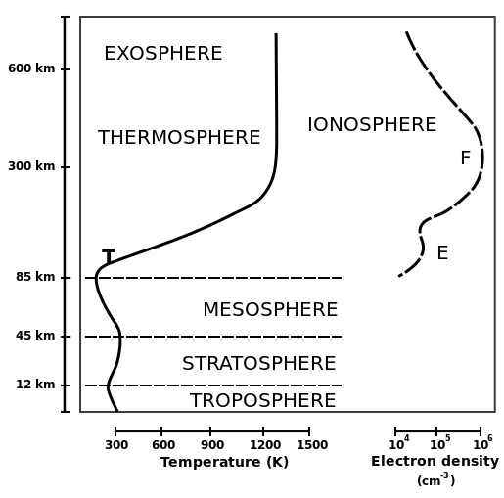
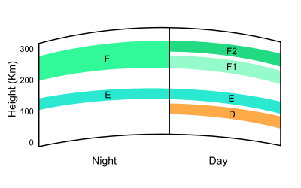
IONOSPHERE
!
Notes:
The ionosphere (/aɪˈɒnəˌsfɪər/[1][2]) is the ionized part of Earth's upper atmosphere, from about 60 km (37 mi) to 1,000 km (620 mi) altitude, a region that includes the thermosphere and parts of the mesosphere and exosphere. The ionosphere is ionized by solar radiation. It plays an important role in atmospheric electricity and forms the inner edge of the magnetosphere. It has practical importance because, among other functions, it influences radio propagation to distant places on the Earth.[3]
The Total Electron Content (TEC) is the integrated total number of electrons present along a path between a radio transmitter and receiver.

Slide 14
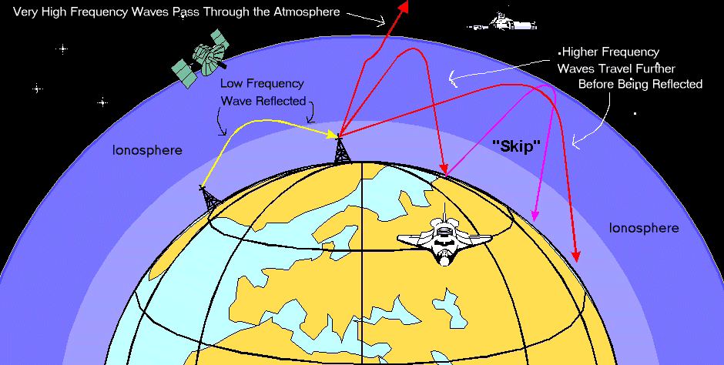
RAdio waves
!
Notes:
The ionospheric has the ability to reflect radio waves. If the degree of ionisation would be zero, no radio waves would be reflected and all would pass.
Ionisation can change over time.
Ionisation is not the same everywhere.
HF goes through
LF are reflected
During the night, the ionisation decreases - the skill to reflect drops.
—> also LF goes through —> Maximum Usable Frequency, MUF decreases.

Slide 15
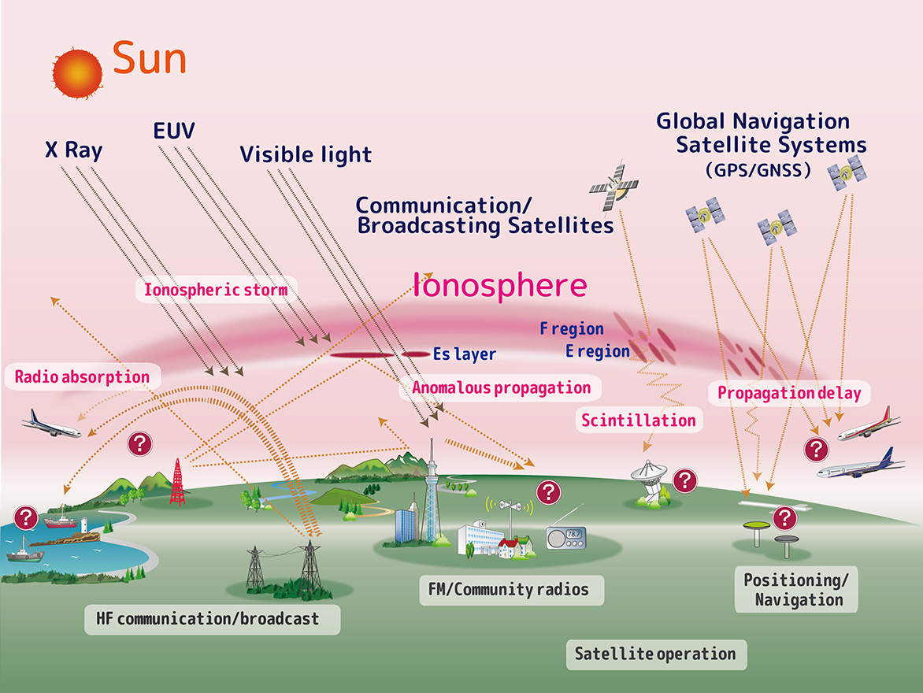
IONOSPHERIC STORMS
!
Notes:
How the ionosphere behaves has an impact on HF communication and navigation
Ionospheric storms primarily affect the equatorial regions but can also extend into the middle latitudes and affect GNSS navigation.

Slide 16

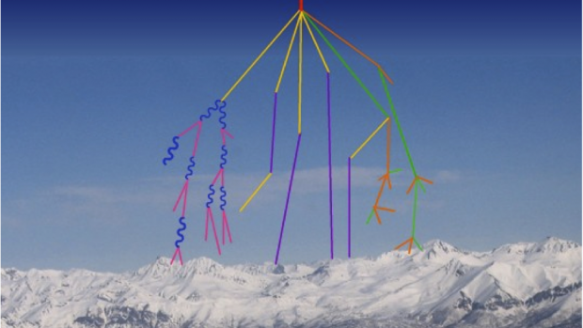
Galactic cosmic rays
Galactic Cosmic Rays (GCR) are the slowly varying, highly energetic background source of energetic particles that constantly bombard Earth. GCR originate outside the solar system and are likely formed by explosive events such as supernova.
Notes:
Neutron monitors:
They measure energetic particles at the earth surface. It measures the background radiation - which is always present and are in fact the GCR. This background radiation is modulated by solar activity, they are in anti-phase: high solar activity/strong solar wind corresponds to less GCR on earth.
The neutron monitors can measure a Ground Level Event, GLE. There will be a peak on top of the background GCR.
You can have a GLE in case of a strong Solar Energetic Proton storm.
http://www.swpc.noaa.gov/phenomena/galactic-cosmic-rays
Galactic Cosmic Rays (GCR) are the slowly varying, highly energetic background source of energetic particles that constantly bombard Earth. GCR originate outside the solar system and are likely formed by explosive events such as supernova. These highly energetic particles consist of essentially every element ranging from hydrogen, accounting for approximately 89% of the GCR spectrum, to uranium, which is found in trace amounts only. These nuclei are fully ionized, meaning all electrons have been stripped from these atoms. Because of this, these particles interact with and are influenced by magnetic fields. The strong magnetic fields of the Sun modulate the GCR flux and spectrum at Earth.
Over the course of a solar cycle the solar wind modulates the fraction of the lower-energy GCR particles such that a majority cannot penetrate to Earth near solar maximum. Near solar minimum, in the absence of many coronal mass ejections and their corresponding magnetic fields, GCR particles have easier access to Earth. Just as the solar cycle follows a roughly 11-year cycle, so does the GCR, with its maximum, however, coming near solar minimum. But unlike the solar cycle, where bursts of activity can change the environment quickly, the GCR spectrum remains relatively constant in energy and composition, varying only slowly with time. (See Forbush decrease for short-term changes of GCR related to space strong solar events)
These charged particles are traveling at large fractions of the speed of light and have tremendous energy. When these particles hit the atmosphere, large showers of secondary particles are created with some even reaching the ground. These particles pose little threat to humans and systems on the ground, but they can be measured with sensitive instruments. The Earth’s own magnetic field also works to protect Earth from these particles largely deflecting them away from the equatorial regions but providing little-to-no protection near the polar regions or above roughly 55 degrees magnetic latitude (magnetic latitude and geographic latitude differ due to the tilt and offset of the Earth’s magnetic field from its geographic center). This constant shower of GCR particles at high latitudes can result in increased radiation exposures for aircrew and passengers at high latitudes and altitudes. Additionally, these particles can easily pass through or stop in satellite systems, sometimes depositing enough energy to result in errors or damage in spacecraft electronics and systems.
Image courtesy of: http://www.windows2universe.org/physical_science/physics/atom_particle/cosmic_ray_spallation_big.jpg
(link is external)
Impacts: Satellites Humans in Space Passengers and Crew on aircraft at high latitudes (polar routes)

Slide 17
Impact on technology
Nevertheless, our technology is impacted. PECASUS concerns impacts on aviation operations.
Radiation
effects
HF COM effects
GNSS
effects
Notes:
Monitoring & forecasting space weather should result in 3 advisory messages.
These messages are called ‘NOTAM’ = NOtice To AirMen
Radiation exposure at flight levels concerns increased exposure to radiation
High Frequency radio communication concerns propagation & absorption of radio waves
GNSS-based navigation and surveillance concerns the degradation of the performance of satellite navigation systems.

Slide 18
Short Rehearsal
Advisories + Concept of Operations + EGs
PECASUS live

Slide 19
HF COM effects
Space Weather Centre
SEVere or MODerate
Forecasts up to 24 HR
We can use also ‘NIGHTSIDE’
OBS SWX
FCST SWC
NO SWX EXP
YYYYMMDD/UTC
Additional info on a web-site
Update provided as necessary but
at least after 6 HR

Slide 20
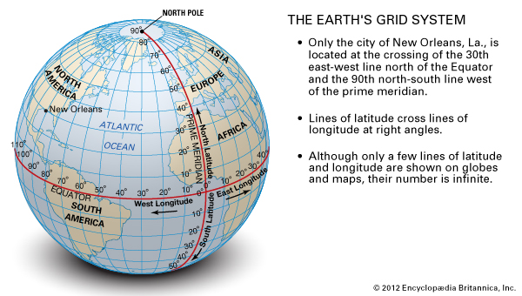

Slide 21
Radiation
effects
Notes:
HNH : High latitudes northern hemisphere, i.e. N9000- N6000
MNH : Middle latitudes nothern hemisphere, I.e. N6000- N3000
EQN
EQS
MSH
HSH : High latitudes Southern hemisphere
Solar radiation may be severe above a certain altitude and moderate below. This requires 2 advisories.

Slide 22
HF COM effects
GNSS
effects
Notes:
Note for geomagnetic storm
If an event were strong enough to produce moderate degradation in the equatorial regions, it would likely be severe in the middle and high regions. In this case, there would be two advisories issued, one for the severe event affecting HNH, HSN, MNH and MSH and a second advisory for the moderate event affecting EQN and EQS.

Slide 23
Short Rehearsal
Advisories + Concept of Operations + EGs
PECASUS live

Slide 24
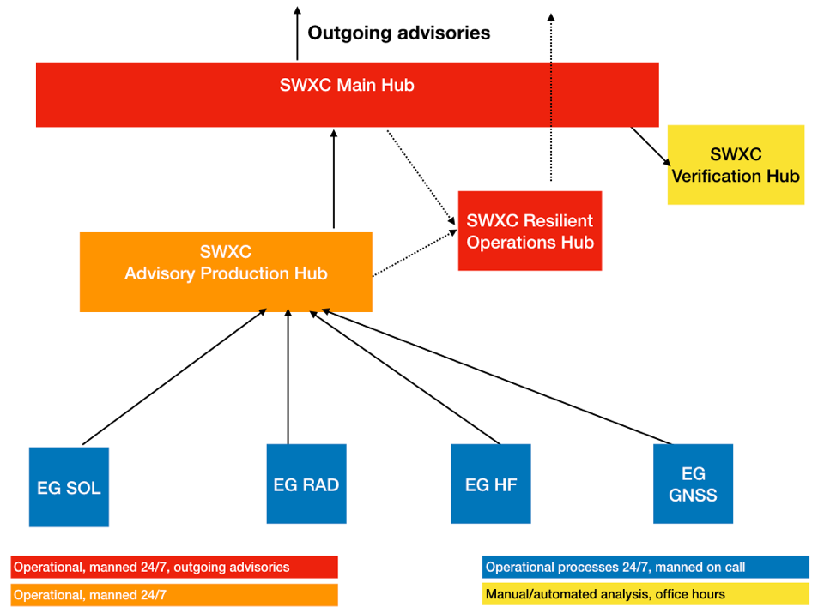



Notes:
EG SOL
EG RAD
EG HF
EG GNSS
Gives all the necessary data to make an advisory in case of MOD or SEV conditions.

Slide 25
Short Rehearsal
Advisories + Concept of Operations + EGs
PECASUS live

Slide 26
Export group sol
The products of the EG SOL are derived from the services of the Regional Warning Center (RWC). The RWC monitors the Sun, makes space weather bulletins and alerts in case of extreme space weather.
RADIO
BLACKOUT
GEOMAGNETIC
STORM
SOLAR RADIATION STORM
SOLAR RADIO BURST

Slide 27
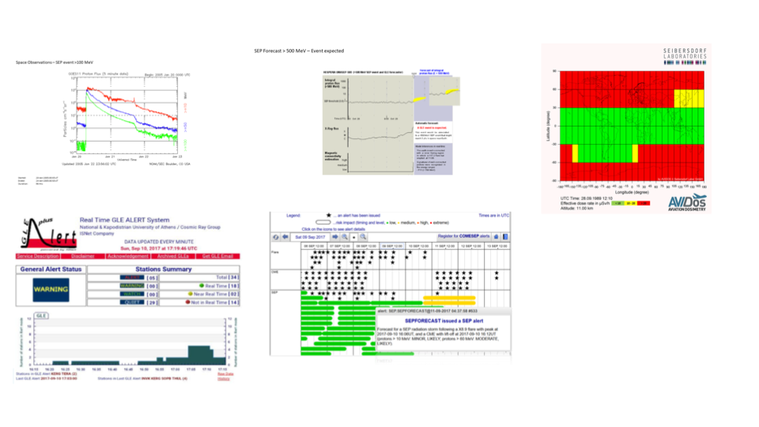
Export group radiation
The products of the EG RADIATION are the results of monitoring the SEP and GCR and the calculation by AVIDOS of the radiation impact at flight level.

Slide 28
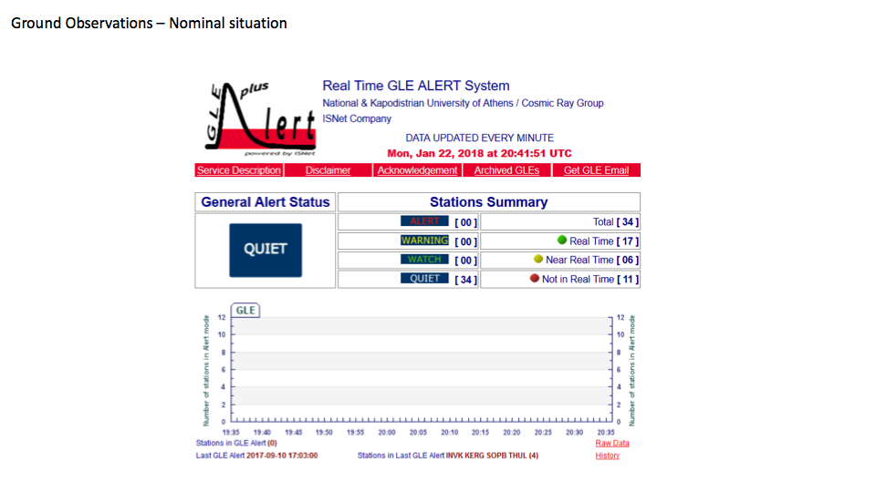
GROUND LEVEL EVENT
Particles

Slide 29
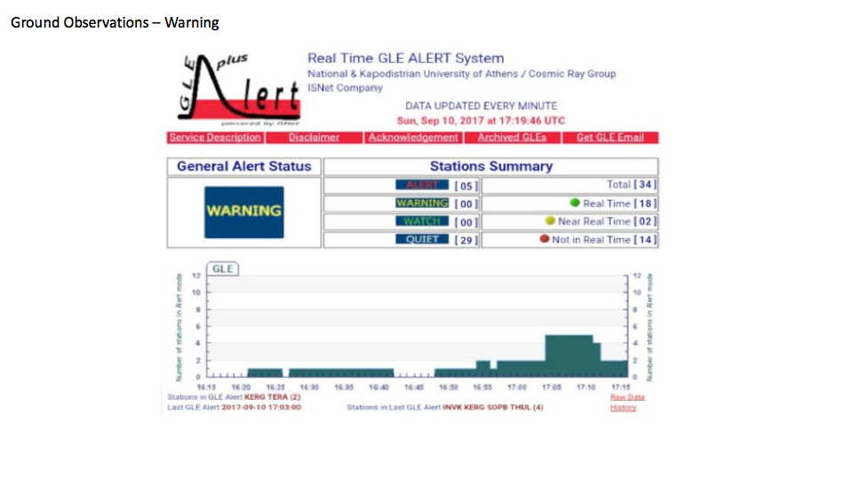
GROUND LEVEL EVENT
Particles

Slide 30
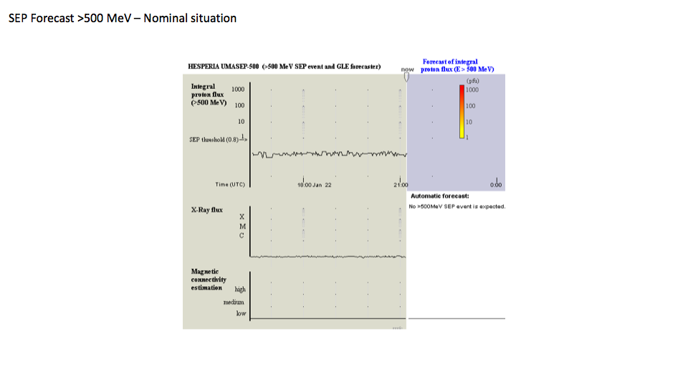
SOLAR ENERGETIC PARTICLES
Particles

Slide 31
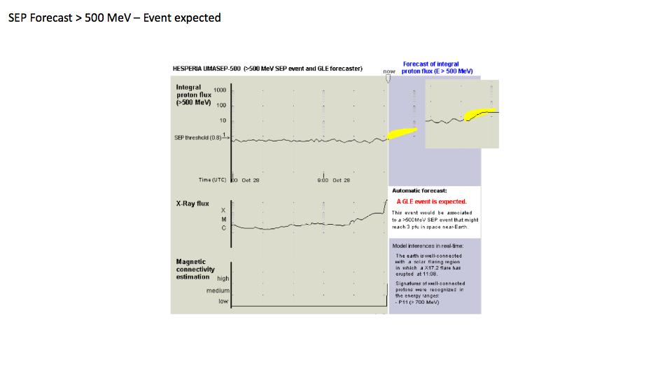
SOLAR ENERGETIC PARTICLES
Particles

Slide 32
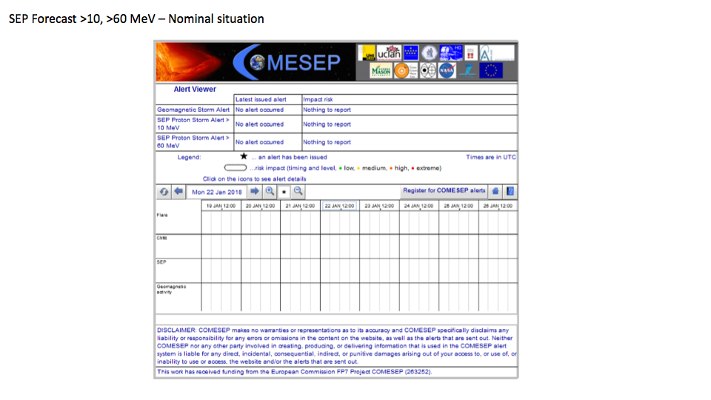
SOLAR ENERGETIC PARTICLES
Particles

Slide 33
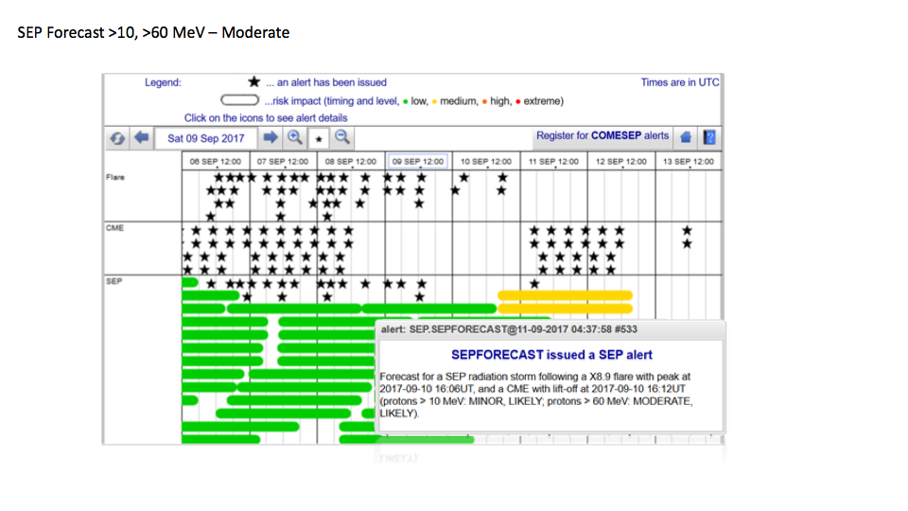
SOLAR ENERGETIC PARTICLES
Particles

Slide 34
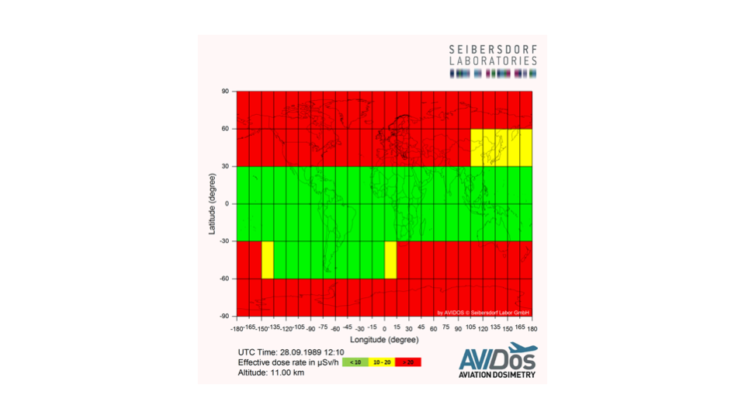
RADIATION ABV FL
Particles

Slide 35
Export group GNSS
The products of the EG GNSS are strongly linked with ionospheric activity and SRB, but also with solar activity. Nicolas will run through all the products.
RADIO
BLACKOUT
GEOMAGNETIC
STORM
SOLAR RADIATION STORM
SOLAR RADIO BURST
IONOSPHERIC
STORMS

Slide 36
Export HF COMMUNICATION
The products of the EG HF are strongly linked with ionospheric activity and SRB, but also with solar activity.
RADIO
BLACKOUT
GEOMAGNETIC
STORM
SOLAR RADIATION STORM
SOLAR RADIO
BURST
IONOSPHERIC
STORMS

Slide 37
Short Rehearsal
Advisories + Concept of Operations + EGs
PECASUS live

