Slide 1
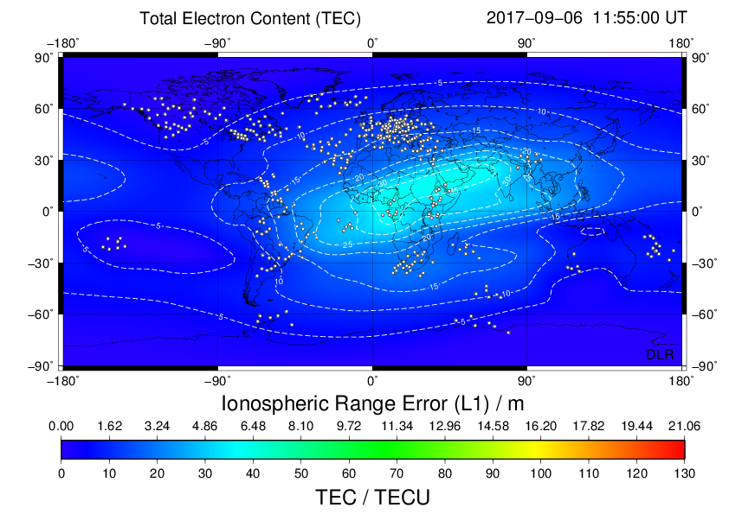
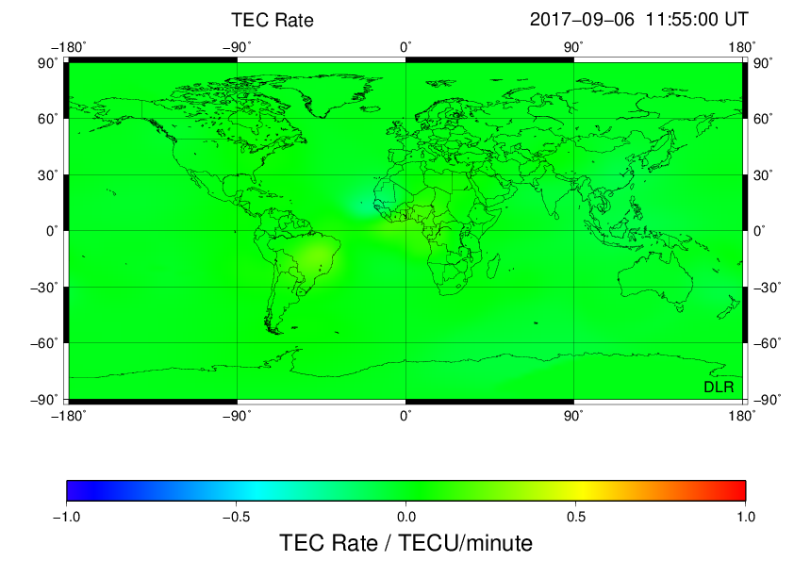
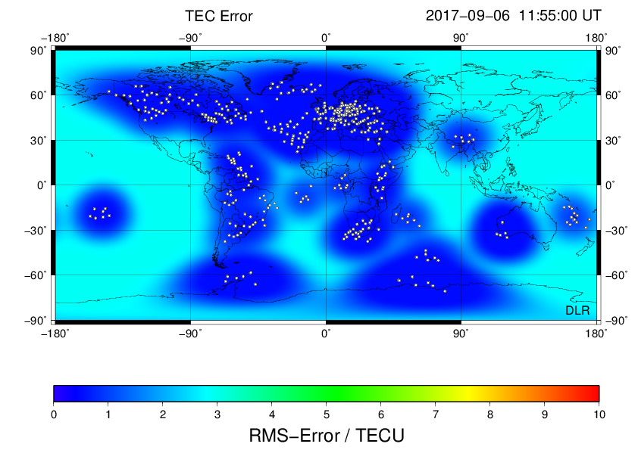
DLR product – Global – TEC and TEC rate
Notes:
TEC map seems to be normal, TEC error is reasonable, no enhancement seen in TEC rate -> product quality would be high-> no alert

Slide 2
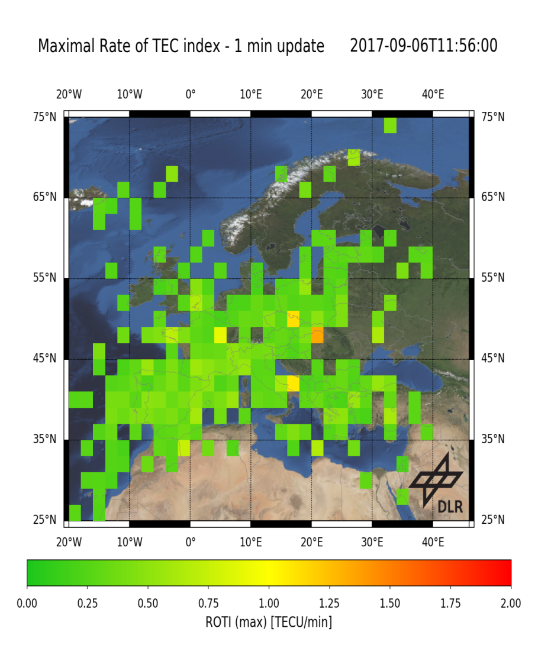
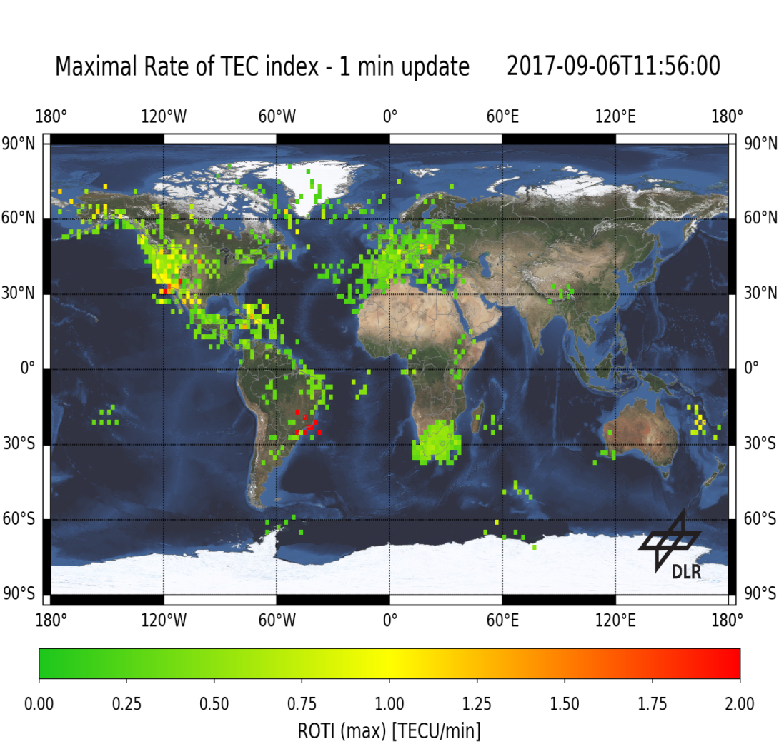
DLR product – Global/EU – ROTI
Notes:
Usual ROTI activity

Slide 3
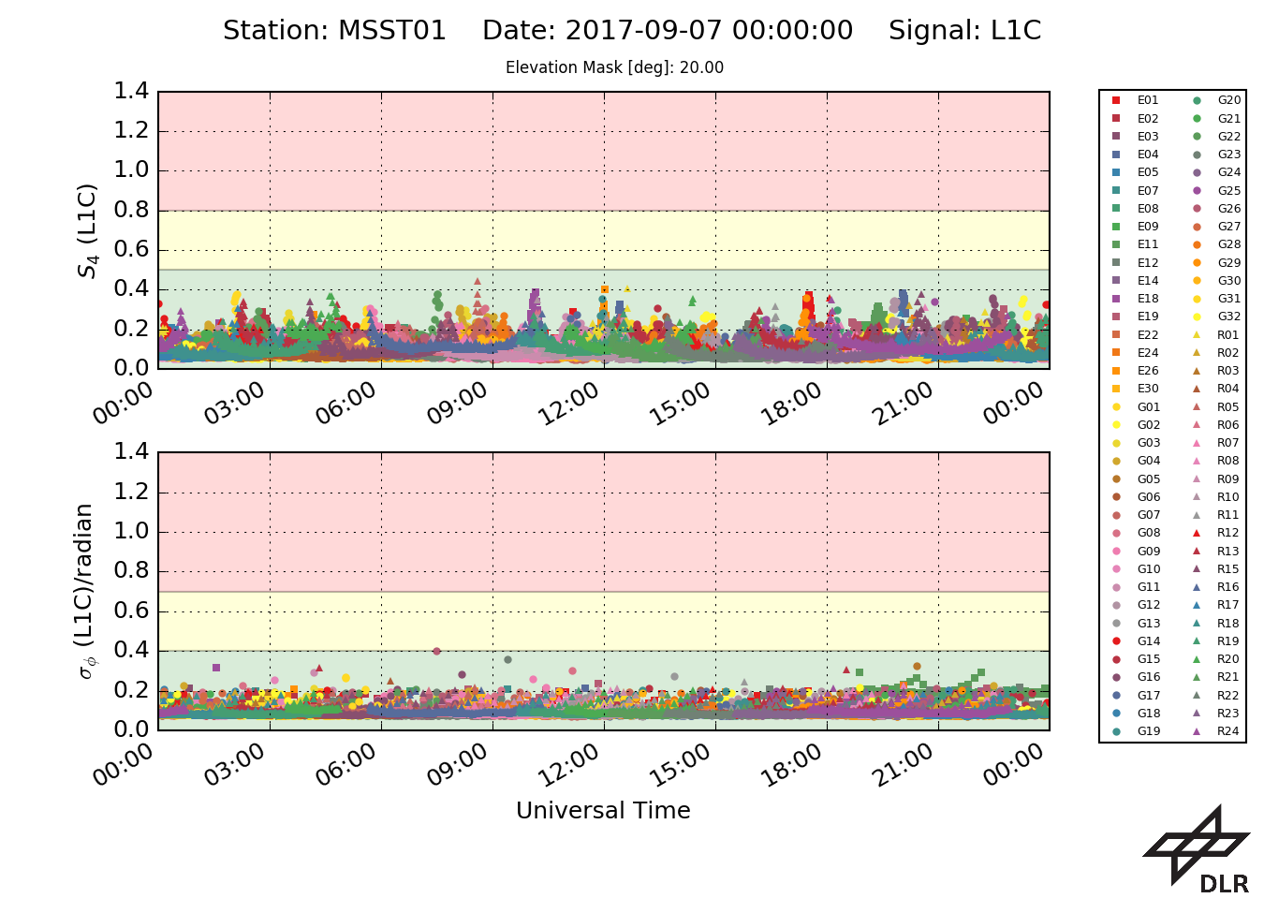
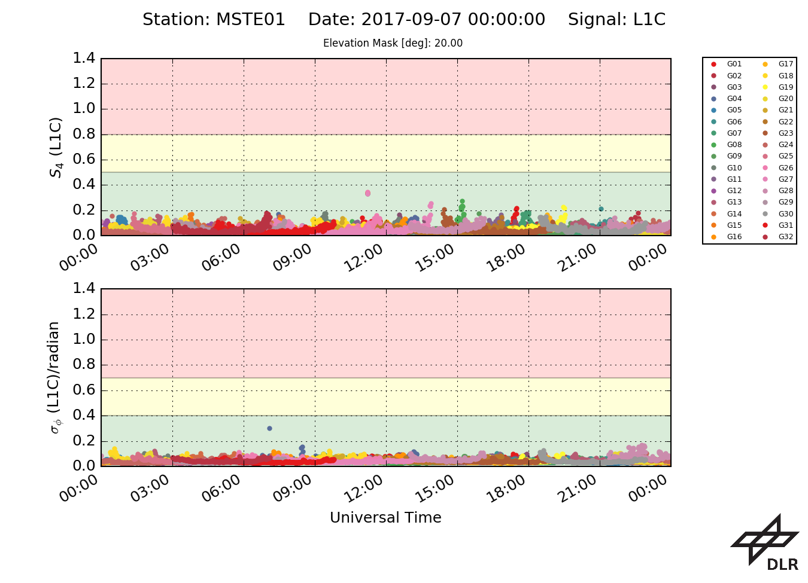
DLR product – Local – Scintillations
Notes:
No clear signature for solar flare event

Slide 4
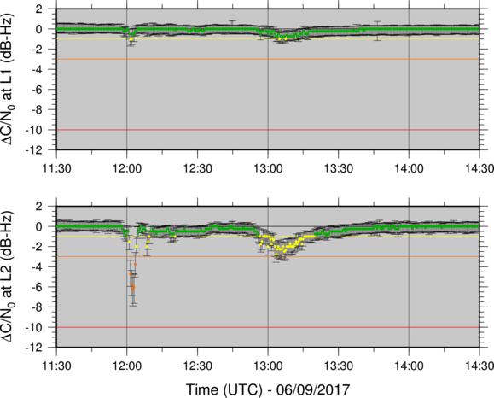
STCE product – Focus on EU.

