Slide 1
Solar radio bursts

Slide 2
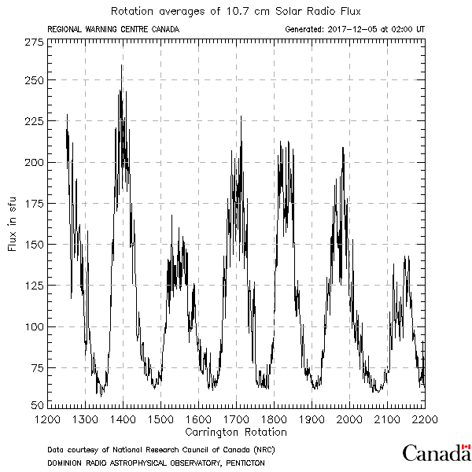
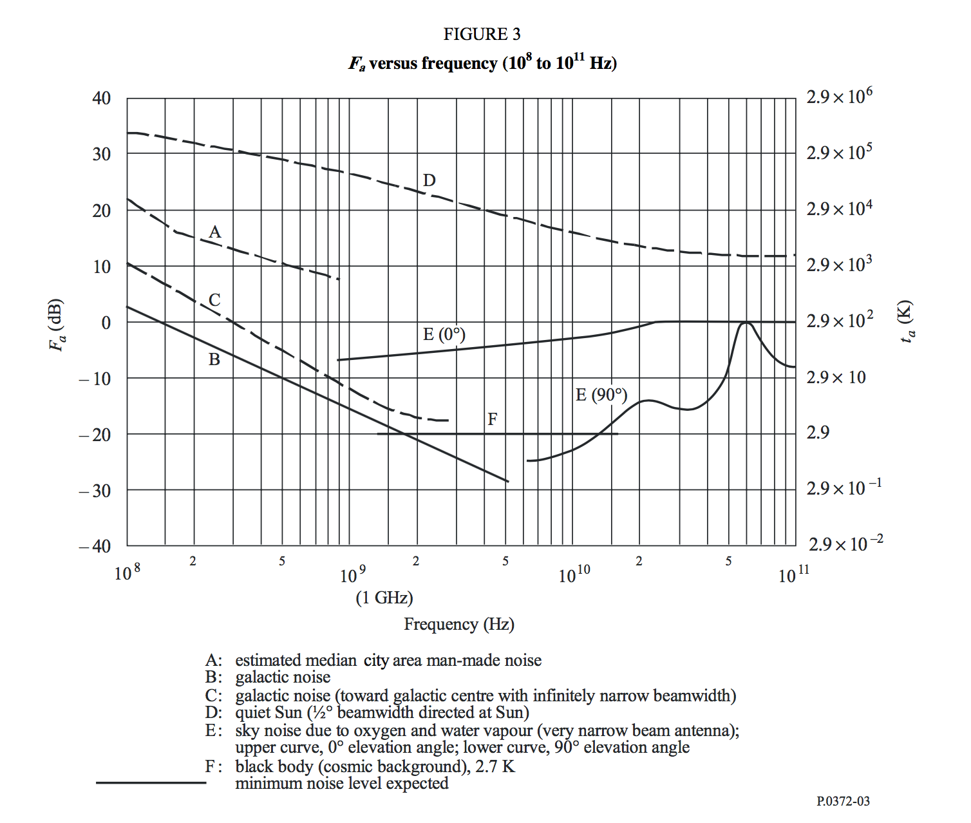
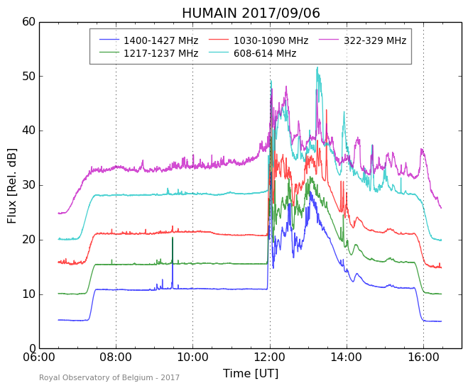
Solar radio emissions
Sun is among the strongest radio source in the sky
Emissions over a large frequency range
Flux of the radio Sun varies on time scales that range from msecs, to days and years
For Space Weather
Frequency range: ~ 20 to ~ 3000 MHz
Monitoring from ground-based instruments

Slide 3
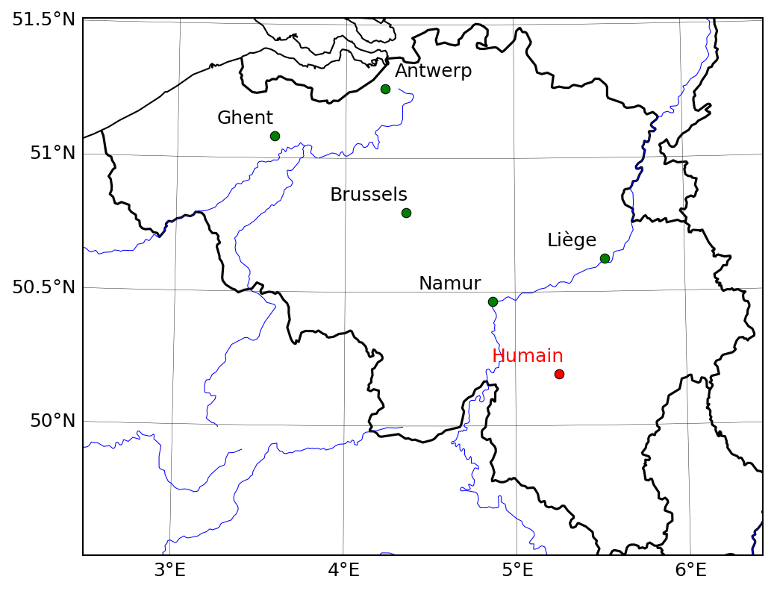
Humain radio astronomy station

Slide 4
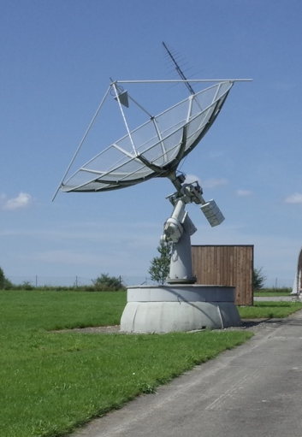
Operational instruments
6-m telescope
Automated system: ~7h30 – 16h00 UT
VHF Antenna
UHF antenna at focus point UHF
VHF antenna (45 – 450 MHz)
  Callisto receiver
  ARCAS receiver
UHF antenna (275 – 1495 MHz)
  HSRS receiver
http://sidc.be/humain

Slide 5
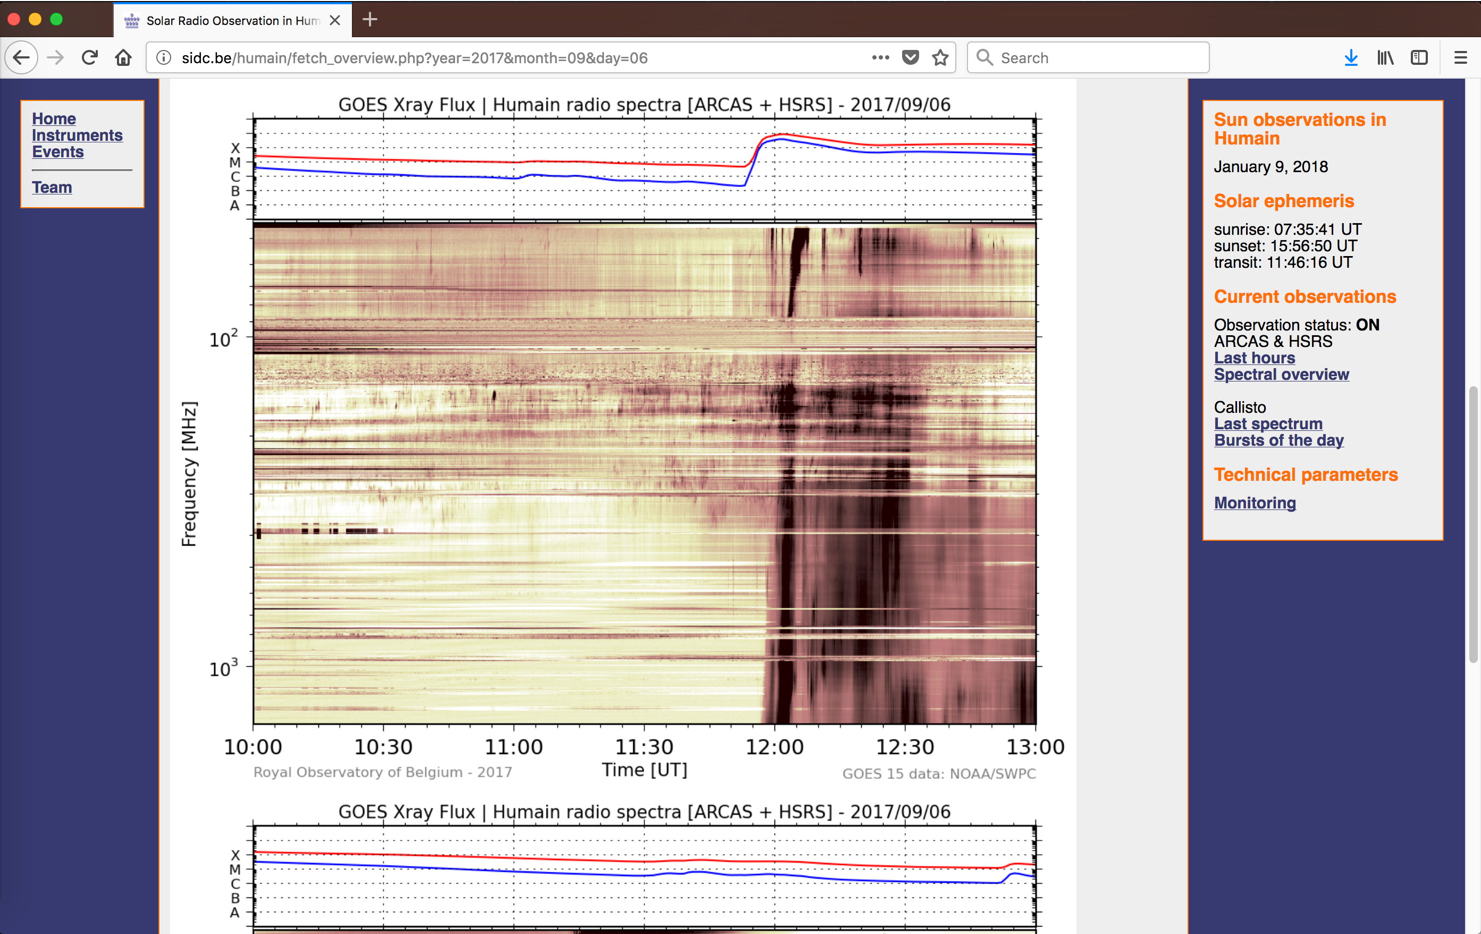

Slide 6
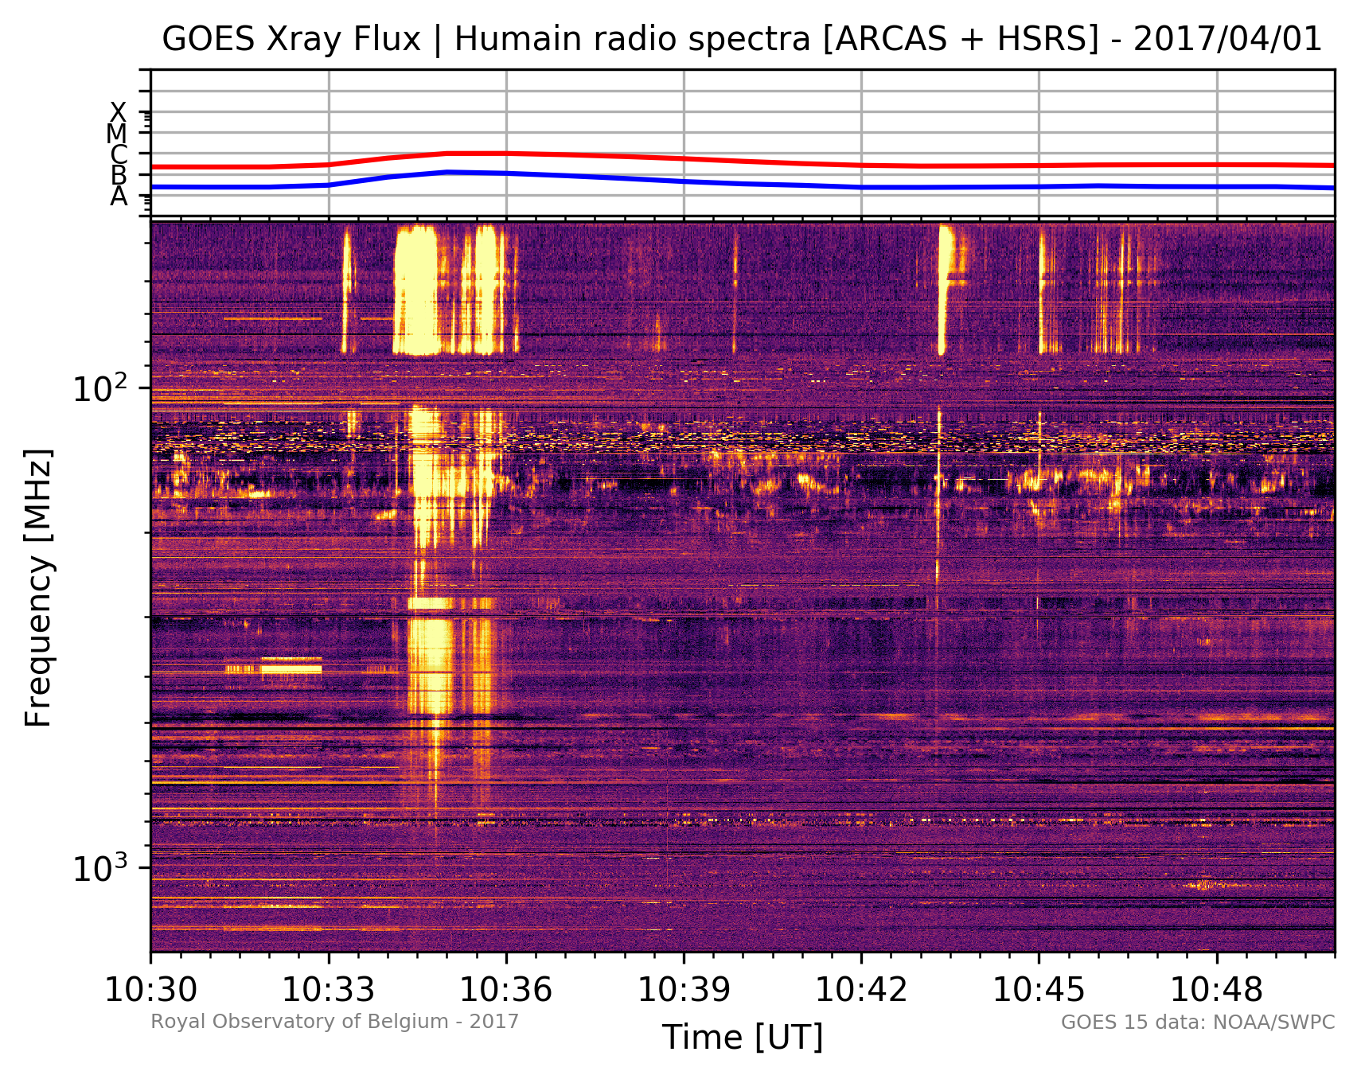
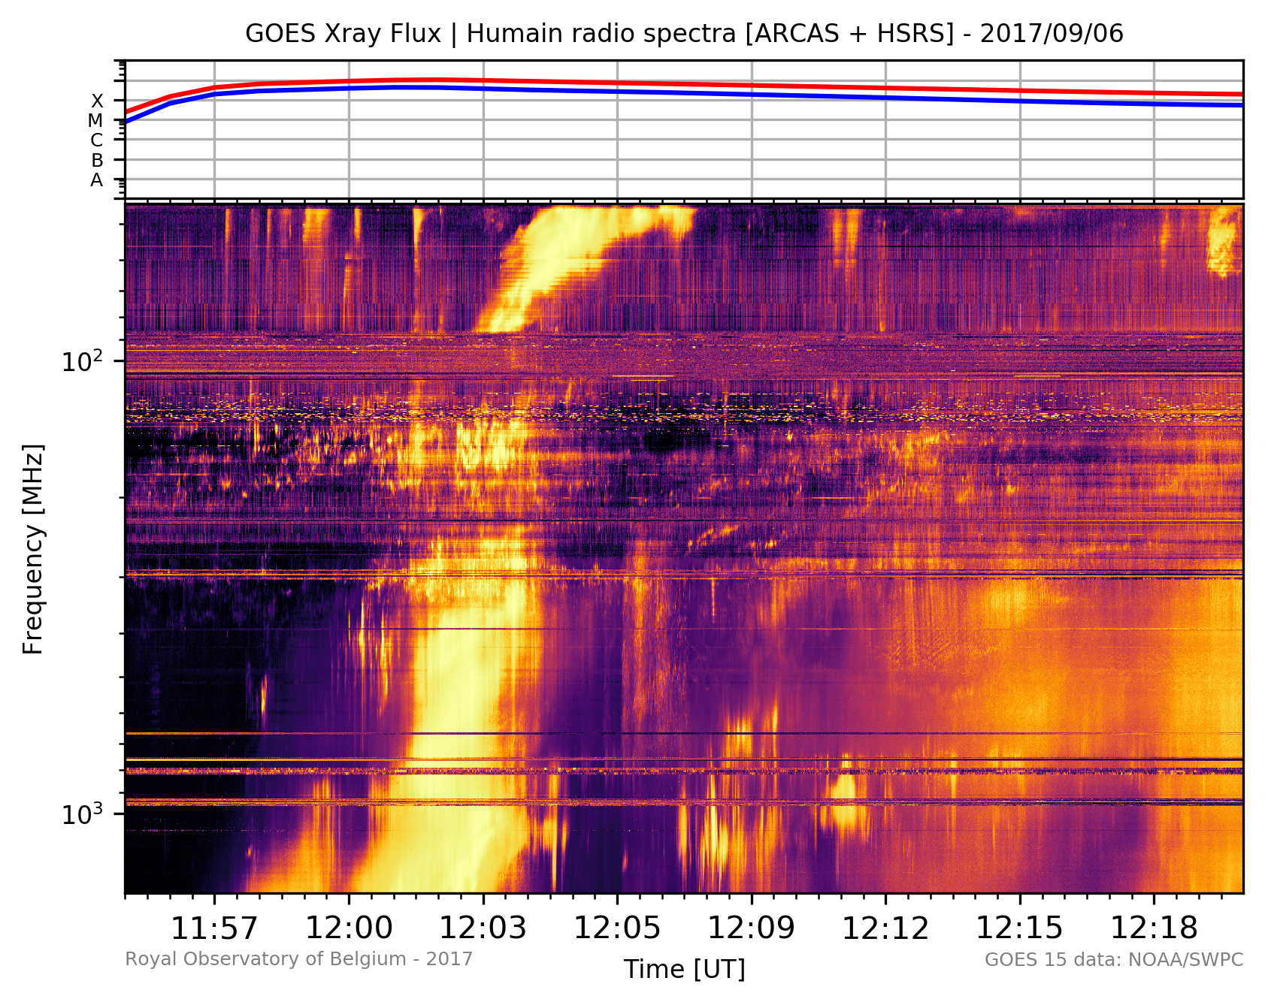
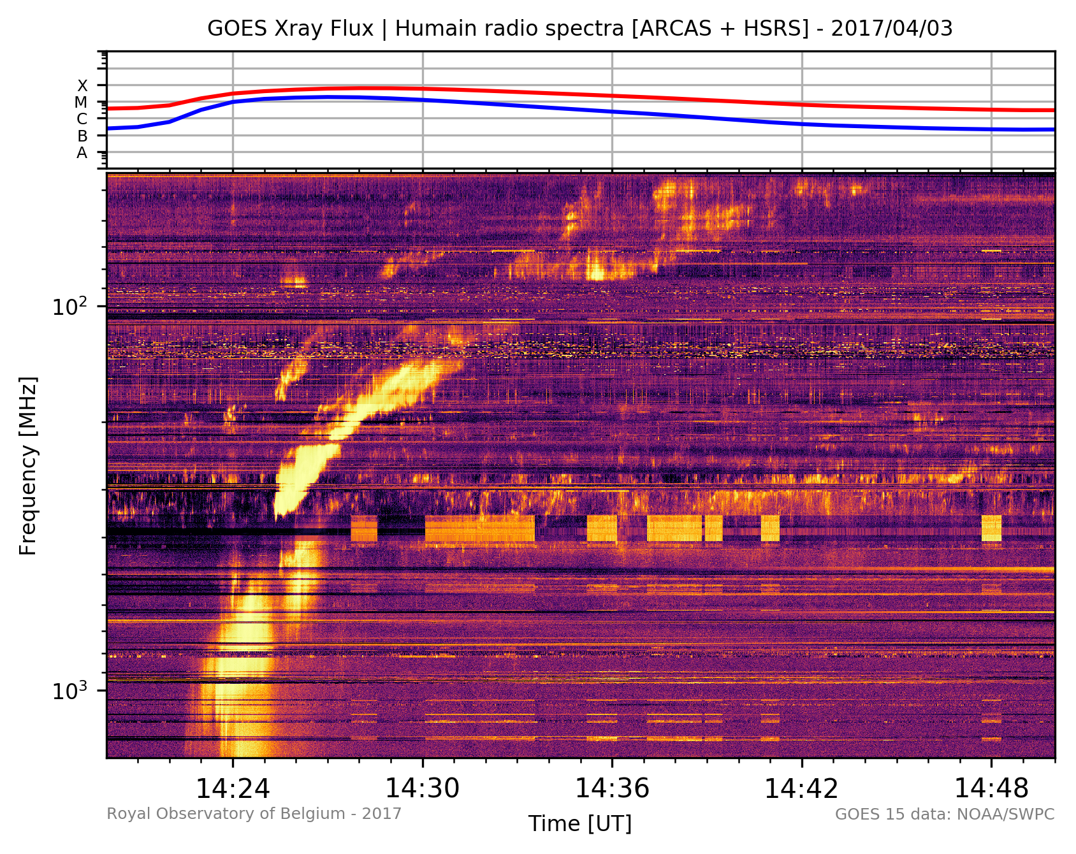
Solar radio bursts
Produced by energetic electrons accelerated by solar eruptive events (micro-flares, flares, filament eruptions, coronal mass ejections)
Typical spectral signatures tells about the fate of these electrons:
  Type I: trapped in loops above A.R.
  Type II: accelerated by shock waves
  Type III: beams accelerated along open magnetic field lines
  Type IV: trapped in post-flare loops

Slide 7
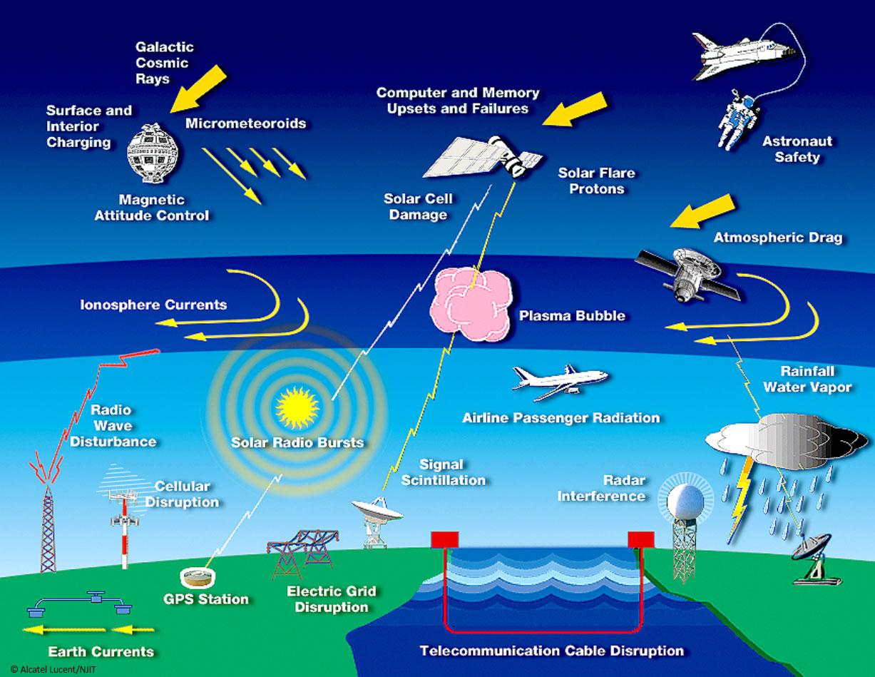
Lanzerotti / Alcatel Lucent

